Slide 1
Time Series Forecasting using R
Prasun Biswas
Shuvayon Dey

Slide 2
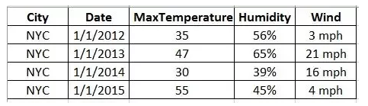
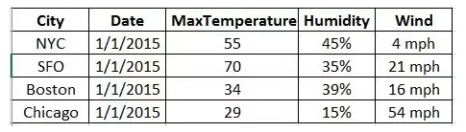
Time Series Analysis
Overview
A time series is a sequence of data points, typically consisting of successive measurements made over a time interval.
Time series data have a natural temporal ordering. This makes time series analysis distinct from cross-sectional studies, in which there is no natural ordering of the observations
Time Series Data
Cross Sectional Data
Notes:
While regression analysis is often employed in such a way as to test theories that the current values of one or more independent time series affect the current value of another time series, this type of analysis of time series is not called "time series analysis", which focuses on comparing values of a single time series or multiple dependent time series at different points in time.
Prediction: An estimation of any event happening [in the past, present or future] e.g. Percentage of house owners buying home insurance
Forecasting: Is always associated with a time dimension in the future i.e. estimation for some specific future duration or over a period of time e.g. Total sales in July, 2017. Forecasting is a subset of prediction.
"Forecasting would be a subset of prediction. Any time you predict into the future it is a forecast. All forecasts are predictions, but not all predictions are forecasts, as when you would use regression to explain the relationship between two variables."

Slide 3
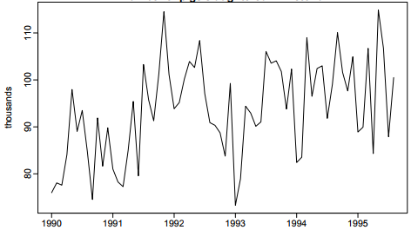
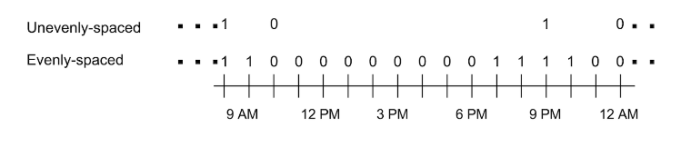
Time Series Analysis
Assumptions
Pattern of past will continue into the future. (else the series will represent a random walk which cannot be modeled or forecasted)
Discrete time series data should be equally spaced over time. There should be no missing values in the training data set (or should be handled using appropriate missing value treatment in the data preparation process).
Time Series Analysis cannot be used to predict effect of random events

Slide 4
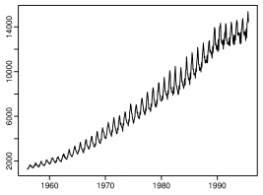
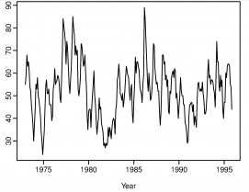
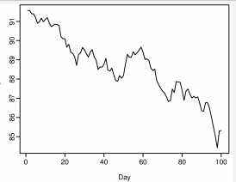
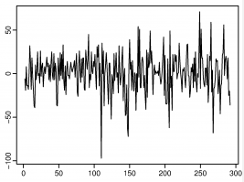
Time Series Analysis
Components of Time Series
Level - Level means average/ mean of a time series.
Trend - A trend exists when there is a long-term increase or decrease in the data. It does not have to be linear. Sometimes we will refer to a trend “changing direction” when it might go from an increasing trend to a decreasing trend. e.g. population growth in India.
Seasonal Pattern - A seasonal pattern exists when a series is influenced by seasonal factors (e.g., the quarter of the year, the month, or day of the week). Seasonality is always of a fixed and known period. e.g. Sales in Target Store in holiday season.
Irregular Component - Disturbances or residual variation that remains after all the other behaviors have been accounted for. e.g. Earthquake
Notes:
The top left diagram shows a strong increasing trend, with strong seasonality. There is no evidence of any cyclic behavior here.
The top right diagram shows strong seasonality within each year, as well as some strong cyclic behavior with period about 6–10 years. There is no apparent trend in the data over this period.
The bottom left diagram shows no seasonality, but an obvious downward trend.
The bottom right has no trend, seasonality or cyclic behavior. There are random fluctuations which do not appear to be very predictable, and no strong patterns that would help with developing a forecasting model.

Slide 5
Time Series Analysis
Decomposition of a time series
Y_{t} = f (L_{t} , T_{t} , S_{t} , E_{t} )
Where, y_{t} = data at period t,
L_{t} = Level component at time period t,
S_{t} = seasonal component at period t,
T_{t} = trend-cycle component at period t and
E_{t} = remainder (or irregular or error) component at period t. Then,
Additive Model: y_{t} = L_{t} + T_{t} + S_{t} + E_{t.}
Multiplicative model: y_{t} =L_{t} * T_{t} * S_{t} * E_{t} or equivalently, log y_{t} = log L_{t} + log T_{t} + log S_{t} + log E_{t}
In a time series data as a first step remove Trend and Seasonality factors to catch the Random effect of the series.
The process of removal of Trend component is called de-trending.
The process of removal of Seasonal component is called de-seasonalization.
Notes:
The additive model is most appropriate if the magnitude of the seasonal fluctuations or the variation around the trend-cycle does not vary with the level of the time series.
If seasonal fluctuations are proportional to level of series, then multiplicative model is appropriate.

Slide 6
Time Series Analysis
Decomposition of a time series
The classical decomposition method originated in the 1920s.
It is a relatively simple procedure and forms the basis for most other methods of time series decomposition.
There are two forms of classical decomposition: an additive decomposition and a multiplicative decomposition.
In classical decomposition, we assume the seasonal component is constant from year to year. These are sometimes called the “seasonal indices”.
Problems:
The estimate of the trend is unavailable for the first few and last few observations. For example, if m=12, there is no trend estimate for the first six and last six observations.
Classical decomposition methods assume that the seasonal component repeats from year to year.
Occasionally, the value of the time series in a small number of periods may be particularly unusual.
CODE:
# x is the time series
plot(dj,main="Dow Jones Index (daily ending 15 Jul 94)",xlab="Day",ylab="")
ts.dj<-ts(dj,frequency=7)
dec.dj<-decompose(ts.dj)
plot(dec.dj)
Notes:
Additive decomposition
Step 1: If m is an even number, compute the trend-cycle component using a 2×m-MA to obtain T_{t}. If m is an odd number, compute the trend-cycle component using an mm-MA to obtain T_{t}.
Step 2: Calculate the de-trended series: y_{t} ⁻ T_{t}.
Step 3: To estimate the seasonal component for each month, simply average the detrended values for that month. These seasonal indexes are then adjusted to ensure that they add to zero. The seasonal component is obtained by stringing together all the seasonal indices for each year of data. This gives S_{t}.
Step 4: The remainder component is calculated by subtracting the estimated seasonal and trend-cycle components: E_{t}=y_{t} - T_{t} - S_{t}.
Multiplicative decomposition
A classical multiplicative decomposition is very similar except the subtractions are replaced by divisions.
Step 1: If m is an even number, compute the trend-cycle component using a 2×m -MA to obtain T_{t}. If m is an odd number, compute the trend-cycle component using an m-MA to obtain T_{t}.
Step 2: Calculate the detrended series: y_{t}/T_{t}.
Step 3: To estimate the seasonal component for each month, simply average the detrended values for that month. For example, the seasonal index for March is the average of all the detrended March values in the data. These seasonal indexes are then adjusted to ensure that they add to mm. The seasonal component is obtained by stringing together all the seasonal indices for each year of data. This gives S_{t}.
Step 4: The remainder component is calculated by dividing out the estimated seasonal and trend-cycle components: E_{t}=y_{t}/(T_{t}S_{t}).

Slide 7
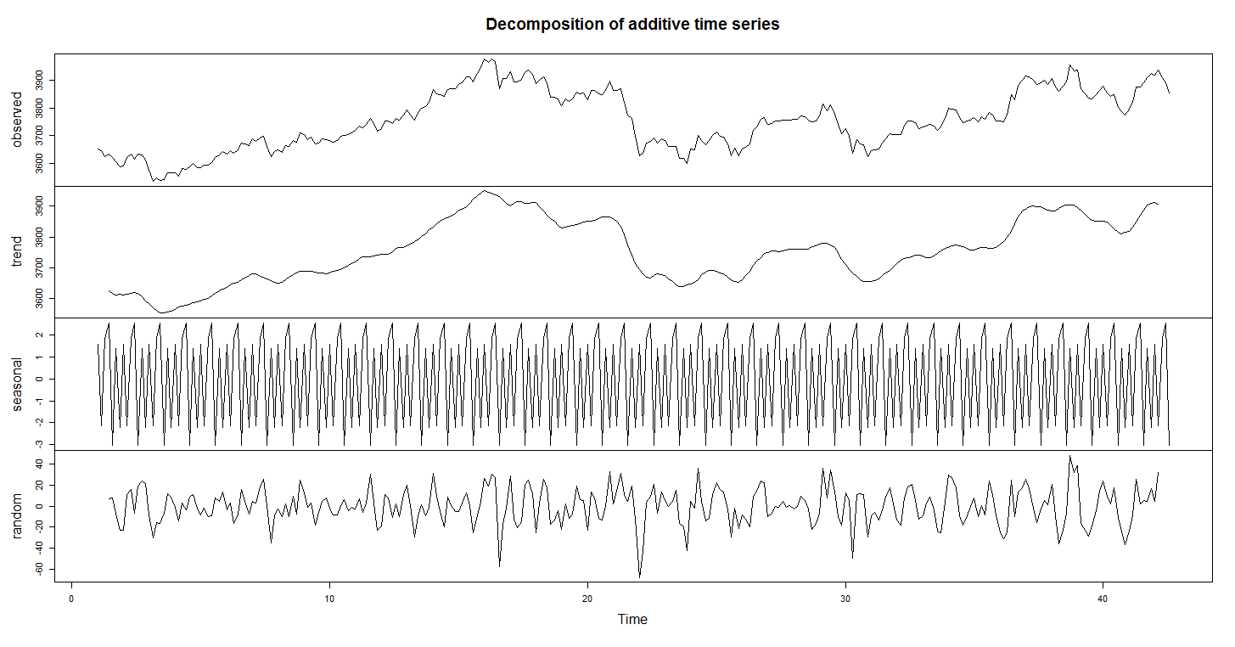
Time Series Analysis
Decomposition of a time series

Slide 8
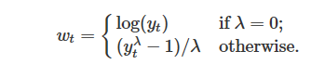
Time Series Analysis – Mathematical Concepts
Log Transformation
If the data show variation that increases or decreases with the level of the series, then a transformation can be useful.
For example, a logarithmic transformation is often useful. If we denote the original observations as y₁,…,y_{T} and the transformed observations as w₁ ,…,w_{T}, then w_{t} =log(y_{t}).
A useful family of transformations that includes logarithms and power transformations is the family of "Box-Cox transformations", which depend on the parameter λ and are defined as follows:
The logarithm in a Box-Cox transformation is always a natural logarithm (i.e., to base e). So if λ=0 , natural logarithms are used, but if λ≠0 , a power transformation is used followed by some simple scaling.
R code:
# The BoxCox.lambda() function will choose a value of lambda for you. lambda <- BoxCox.lambda()
Notes:
Features of power transformations:
If some y_{t}≤0 , no power transformation is possible unless all observations are adjusted by adding a constant to all values.
Choose a simple value of λ. It makes explanations easier.
Forecasting results are relatively insensitive to the value of λ .
Often no transformation is needed.
Transformations sometimes make little difference to the forecasts but have a large effect on prediction intervals.

Slide 9
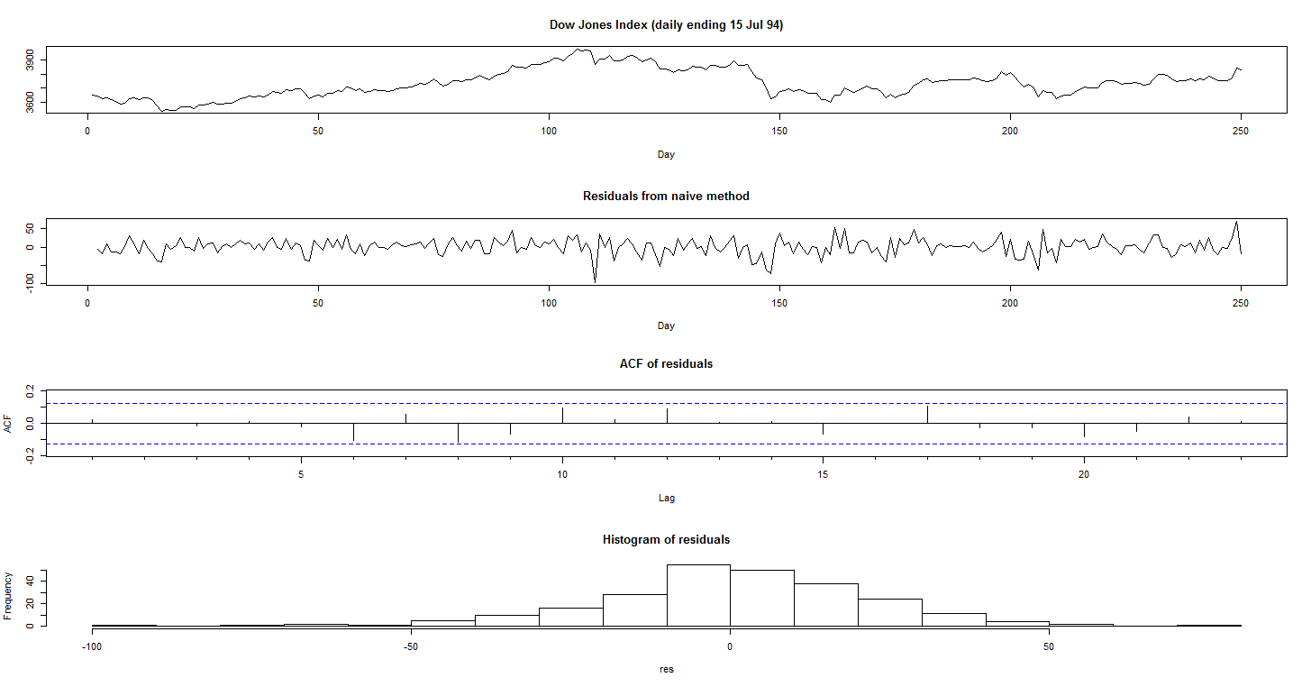
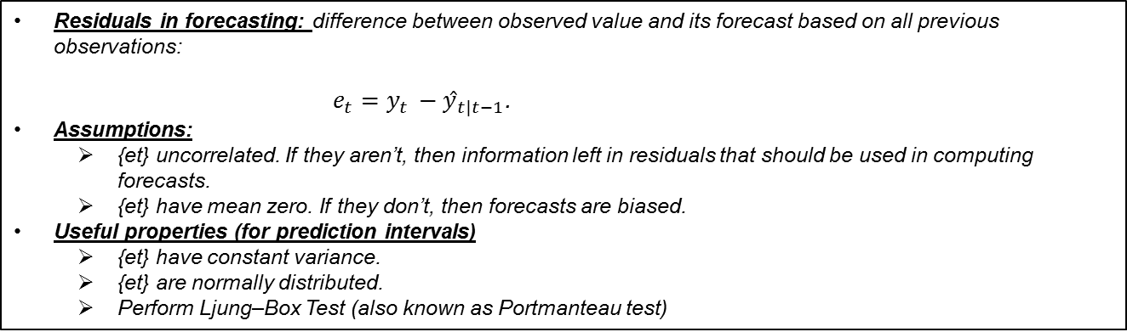
Time Series Analysis – Mathematical Concepts
Residual Analysis
Residuals in forecasting: difference between observed value and its forecast based on all previous observations:
$e_{t}=y_{t }−ŷ_{t|t−1}$.
Assumptions:
{et} uncorrelated. If they aren’t, then information left in residuals that should be used in computing forecasts.
{et} have mean zero. If they don’t, then forecasts are biased.
Useful properties (for prediction intervals)
{et} have constant variance.
{et} are normally distributed.
Perform Ljung–Box Test (also known as Portmanteau test)
Notes:
Notes:
Adjusting for bias is easy: if the residuals have mean m , then simply add m to all forecasts and the bias problem is solved.
Ljung Box Test:
H₀: The data are independently distributed
H₁: The data are not independently distributed; they exhibit serial correlation.
Here, if the residuals are white noise then we should get a p-value more than 0.05, confirming the fact that the residuals are indeed independently distributed

Slide 10
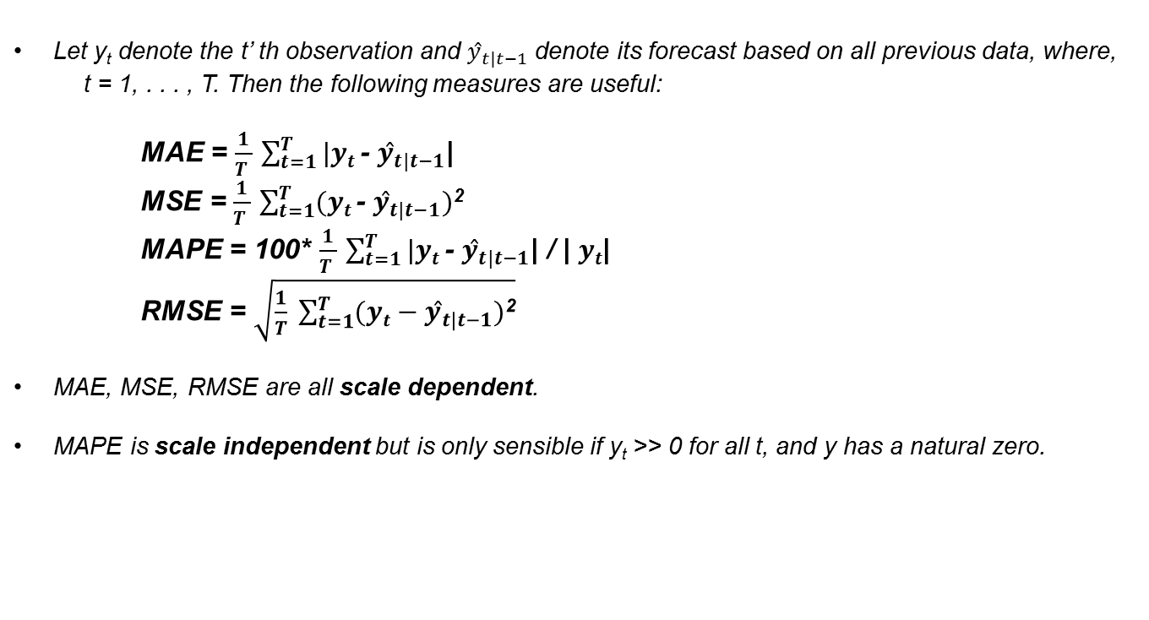
Time Series Analysis – Mathematical Concepts
Measures of forecast accuracy
Let y_{t} denote the t’ th observation and $ŷ_{t|t−1}$ denote its forecast based on all previous data, where,
t = 1, . . . , T. Then the following measures are useful:
MAE = $\frac{1}{T }$ $\sum_{t=1}^{T}{|yt }$- $ŷ_{t|t−1}$|
MSE = $\frac{1}{T }$ $\sum_{t=1}^{T}{(yt }$- $ŷ_{t|t−1})$²
MAPE = 100* $\frac{1}{T }$ $\sum_{t=1}^{T}{|yt }$- $ŷ_{t|t−1}$| / | $yt$|
RMSE = $\sqrt{\frac{1}{T} \sum_{t=1}^{T}{(yt−ŷ_{t|t−1})\text{2}}}$
MAE, MSE, RMSE are all scale dependent.
MAPE is scale independent but is only sensible if y_{t} >> 0 for all t, and y has a natural zero.

Slide 11
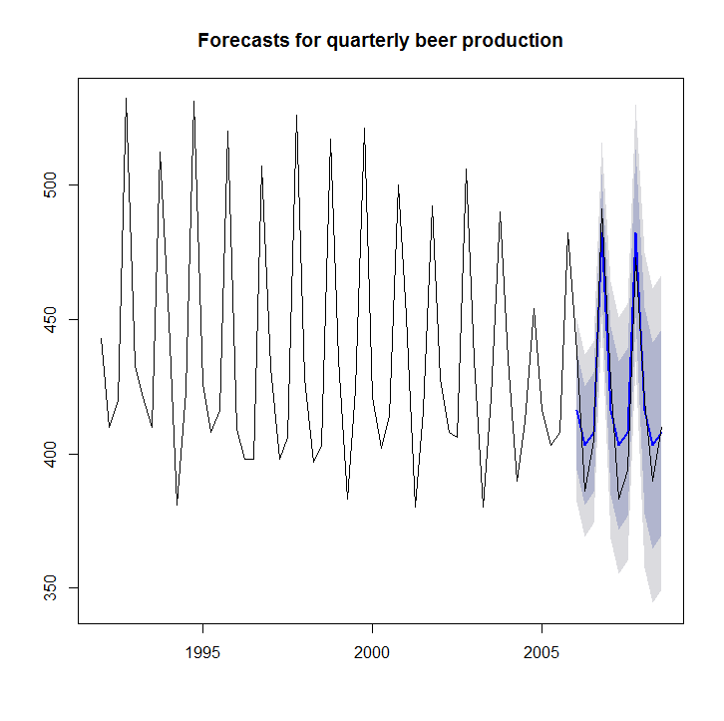
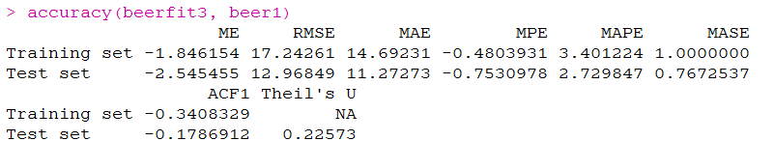
Time Series Analysis – Mathematical Concepts
Measures of forecast accuracy
CODE:
beer1<-window(ausbeer,start=1992)
plot(beer1)
beer2 <- window(ausbeer,start=1992,end=2006-.1)
plot(beer2)
beerfit3 <- snaive(beer2,h=11)
plot(beerfit3, plot.conf=FALSE,main="Forecasts for quarterly beer production")
lines(beer1)
accuracy(beerfit3, beer1)
Notes:
The measures calculated are:
ME: Mean Error
RMSE: Root Mean Squared Error
MAE: Mean Absolute Error
MPE: Mean Percentage Error
MAPE: Mean Absolute Percentage Error
MASE: Mean Absolute Scaled Error
ACF1: Autocorrelation of errors at lag 1.

Slide 12
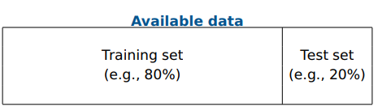
Time Series Analysis – Mathematical Concepts
Over Fitting
A model which fits the data well does not necessarily forecast well.
A perfect fit can always be obtained by using a model with enough parameters.
Over-fitting a model to data is as bad as failing to identify the systematic pattern in the data.
Problems can be overcome by measuring true out-of-sample forecast accuracy. That is, total data divided into “training” set and “test” set.
Training set used to estimate parameters.
Forecasts are made for test set.
Accuracy measures computed for errors in test set only.
For advanced machine learning based predictions, we can introduce the concept of hyper-parameters tuning to deal with the problem of over fitting. We can also try out regularized regression as well.

Slide 13
Time Series Analysis – Forecasting Models
Time Series Modelling can also be classified as Decomposition based method and Non – Decomposition based method
Decomposition Based
Non – Decomposition Based
1
1
Indexing
STL (Case Study)
2
THETA Model (Case Study)
2
Naive/ Drift (Case Study)
3
3
Moving Average (Case Study)
TBATS (Case Study)
4
Exponential Smoothing Models
(Case Study)
5
ARIMA/ Seasonal ARIMA
(Case Study)

Slide 14
Time Series Analysis
Indexing
Description:
This method is used particularly in excel based processes.
This method can capture seasonality and previous data pattern very well.
Unable to forecast longer periods and mainly used to predict 3-4 monthly values.
No statistical theories are applied here.
Easy to understand.
Steps:
Create a cross tabulation between Month vs Year (or Day vs Month).
Calculate the yearly average.
Create monthly indices based on these yearly average values.
Calculate average index for each month. (ideally we should calculate average index for the normal years)
Now, based on these indices, perform the forecasting.
Ideally, we should select that model which has the minimum MAPE.

Slide 15
Time Series Analysis
Moving Average
Moving average (MA) techniques predicts the value of a period by considering the average value of some specified prior periods. MA is useful in random series i.e. series without trend and seasonality. It averages or smoothes the most recent actual values to remove unwanted randomness.
For example: In a 3 period moving: M₃ = (Y₃+ Y₂ + Y₁) / 3; M₄ = (Y₄+ Y₃ + Y₂) / 3
Thus, each new forecast moves ahead by 1 period by adding the newest actual and dropping the oldest actual.
K-period Moving Average : M_{t}= [ Y_{t} + Y_{t-1} + ... + Y_{t-K+1} ] / K, where
Y _{t}= observed series, K = total number of periods in the average
Forecasting Equations: Y_{t+1} = M_{t} and, F_{t+1} = M_{t+1}; where M_{t} = Forecasted Series
Choice of K/Optimal Period : A smaller value of K is appropriate if the underlying pattern is changing or if there is a small term fluctuation 6. A larger value of K is appropriate if underlying pattern of demand is stable.
Weighted Moving Average: M_{t} = [ W₁ * Y_{t} + W₂ * Y_{t-1} + ... + W_{K} * Y_{t-K+1} ], where
W_{k}= Weights (sum of all weights is equal to 1)
The series where each historical demand may be weighted differently .
Notes:
Important Observation: K-Period Moving Average is a special Case of Weighted moving average where each point is given equal weightage of 1/K
Centred MA is mostly used to understand the nature of trend in a given time series. This can be computed using the ma() function in R present in the fpp package.
For the use of forecasting we shall use the rollmean function present in zoo package in R. The main difference between the two techniques is the placement of window width.

Slide 16
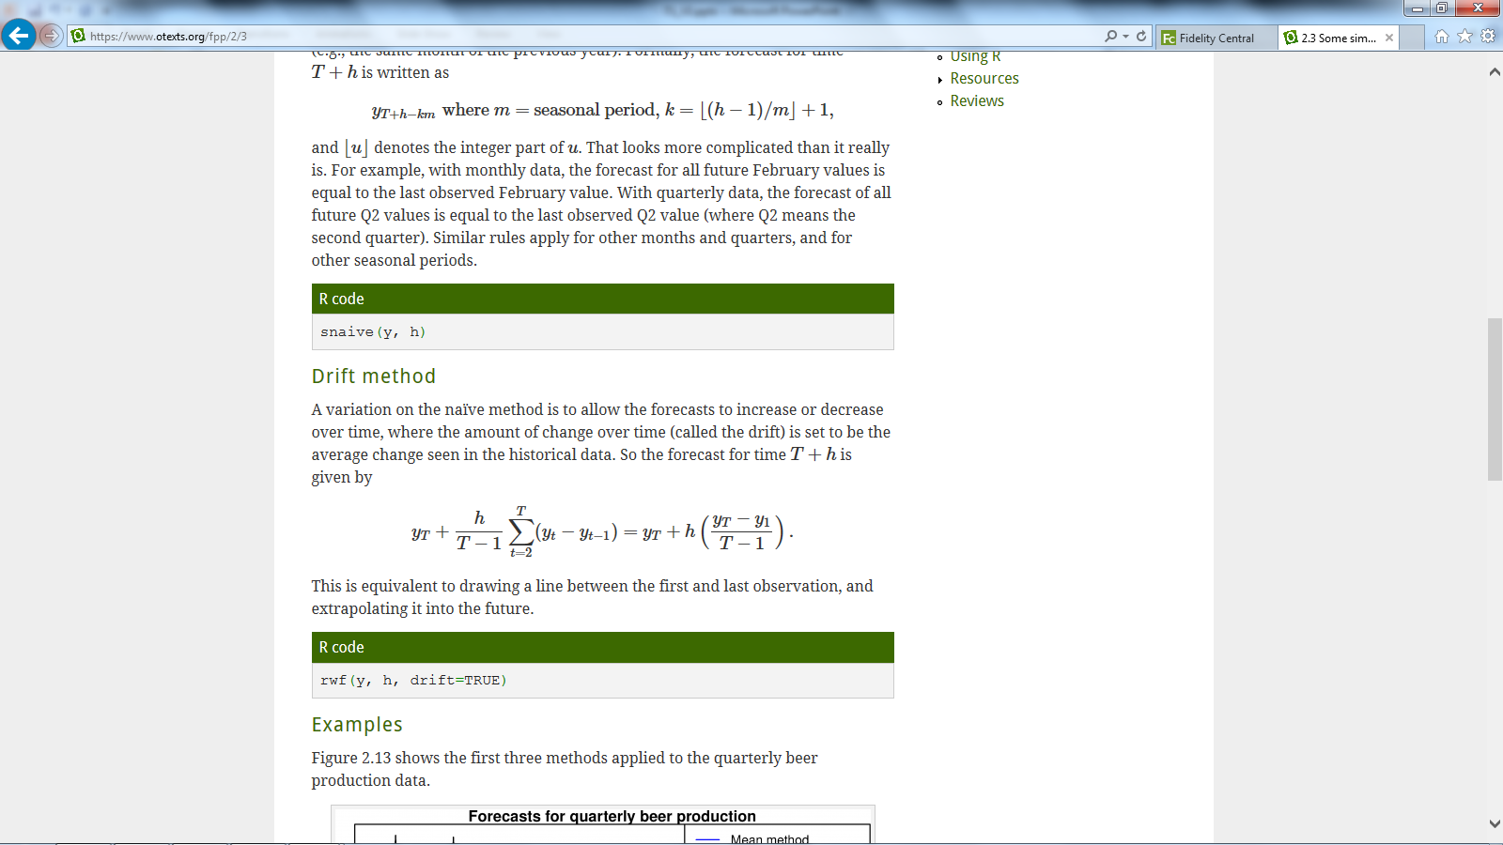
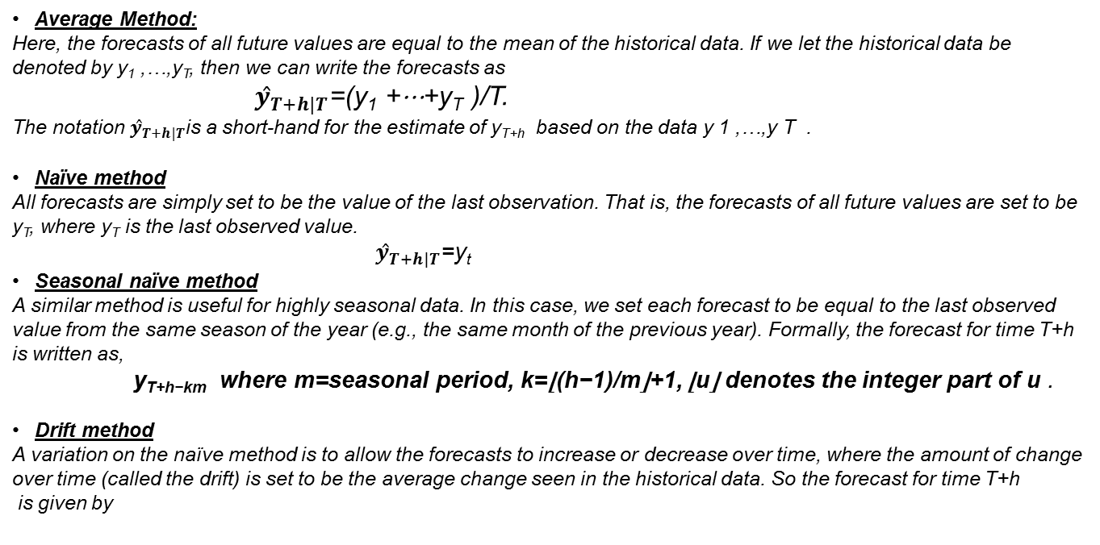
Time Series Analysis
Average, Naïve, Seasonal Naïve and Drift
Average Method:
Here, the forecasts of all future values are equal to the mean of the historical data. If we let the historical data be denoted by y₁ ,…,y_{T}, then we can write the forecasts as
$ŷ_{T+h|T}$=(y₁ +⋯+y_{T} )/T.
The notation $ŷ_{T+h|T}$is a short-hand for the estimate of y_{T+h} based on the data y 1 ,…,y T .
Naïve method
All forecasts are simply set to be the value of the last observation. That is, the forecasts of all future values are set to be y_{T}, where y_{T} is the last observed value.
$ŷ_{T+h|T}$=y_{t}
Seasonal naïve method
A similar method is useful for highly seasonal data. In this case, we set each forecast to be equal to the last observed value from the same season of the year (e.g., the same month of the previous year). Formally, the forecast for time T+h
is written as,
y_{T+h−km} where m=seasonal period, k=⌊(h−1)/m⌋+1, ⌊u⌋ denotes the integer part of u .
Drift method
A variation on the naïve method is to allow the forecasts to increase or decrease over time, where the amount of change over time (called the drift) is set to be the average change seen in the historical data. So the forecast for time T+h
is given by

Slide 17
Time Series Analysis
Exponential Smoothing Models
Very popular technique to produce smoothed Time Series.
The weights assigned to each observations in Exponential smoothing follows an exponential pattern which decreases as the observation gets older and that’s why it is called exponential smoothing.
There are 3 types of smoothing model namely Single/Double/Triple Exponential Model. The choice of exponential models depend on the presence of trend and seasonality in the data
No trend & no seasonality – Single Exponential Smoothing
Trend but No seasonality – Double Exponential
Both Trend & Seasonality – Triple Exponential Smoothing
Holt Winters Model
For non-seasonal series with trend - Trend (T_{t}) at time t defined as the difference between current and previous level.
Therefore Smoothing takes the form of Level Trend, where level is determined as similar to Exponential smoothing.
Level (L_{t}) ---- a y_{t} + (1 - a) (L_{t-1} - T_{t-1} )
Trend(T_{t}) ---- b ( L_{t} - L_{t-1} ) + (1 - b) T_{t-1}
Two smoothing parameters (a,b) are used, both positive and less than 1.
Forecasting for k periods into the future is done as:
F_{n+k} = L_{n} + kT_{n}
Types :
Holt-Winters exponentially smoothed trend seasonal method.
The additive seasonal factors variant of the Winters method
Notes:
Weighted average form (SES)
The forecast at time t+1 is equal to a weighted average between the most recent observation y_{t} and the most recent forecast y_{t|t−1} ,
y_{t+1|t} =αy _{t} +(1−α)y _{t|t−1}
Holts Linear (Damped) Trend
The forecast function is no longer flat but trending. The h-step-ahead forecast is equal to the last estimated level plus h times the last estimated trend value. Hence the forecasts are a linear function of h.

Slide 18
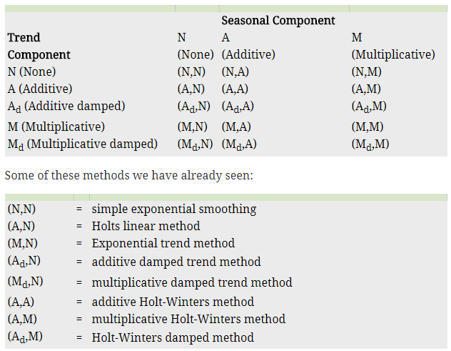
Time Series Analysis
Exponential Smoothing Models - Taxonomy
Exponential smoothing methods are not restricted to those we have presented so far. By considering variations in the combination of the trend and seasonal components, fifteen exponential smoothing methods are possible,
Notes:
For ETS models, Akaike’s Information Criterion (AIC) is defined as
AIC=−2log(L)+2k,where L is the likelihood of the model and k is the total number of parameters and initial states that have been estimated (including the residual variance).
The AIC corrected for small sample bias (AICc) is defined as
AICc=AIC+2k(k+1)T−k−1,
And, the Bayesian Information Criterion (BIC) is
BIC=AIC+k[log(T)−2].
Some of the combinations of (Error, Trend, Seasonal) can lead to numerical difficulties. Specifically, the models that can cause such instabilities are: ETS(M,M,A), ETS(M,Md,A), ETS(A,N,M), ETS(A,A,M), ETS(A,Ad,M), ETS(A,M,N), ETS(A,M,A), ETS(A,M,M), ETS(A,Md,N), ETS(A,Md,A), and ETS(A,Md,M). We normally do not consider these particular combinations when selecting a model.

Slide 19
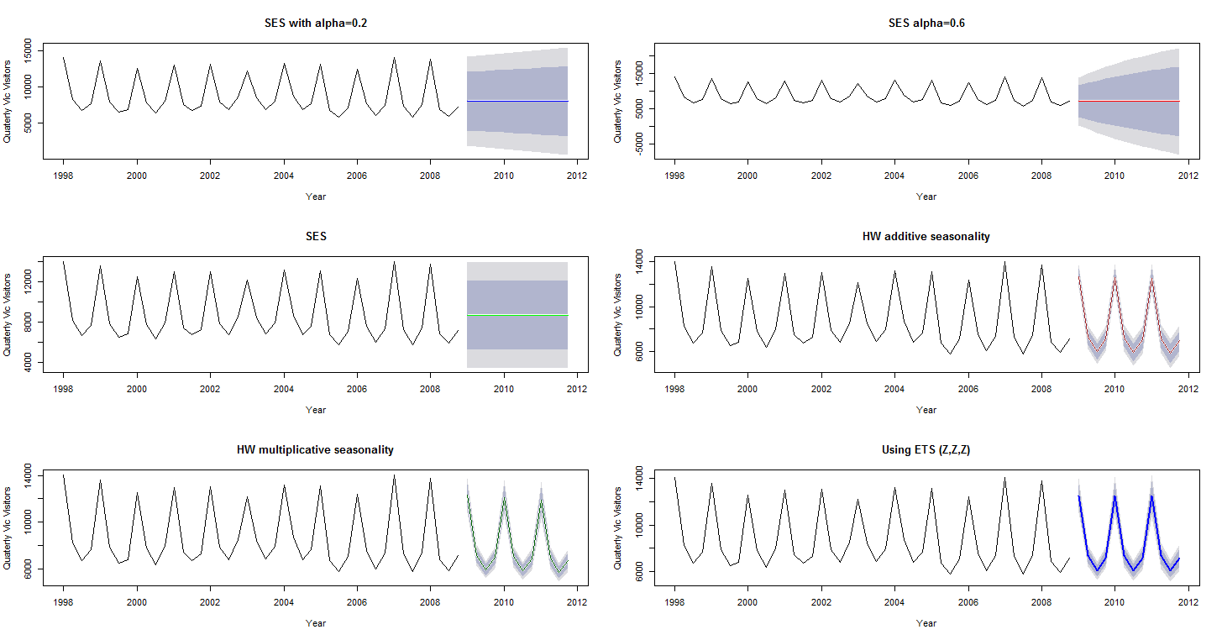
Time Series Analysis
Exponential Smoothing Models
Notes:
R code:
ets(y, model="ZZZ", damped=NULL, alpha=NULL, beta=NULL, gamma=NULL, phi=NULL, additive.only=FALSE, lambda=NULL, lower=c(rep(0.0001,3), 0.8), upper=c(rep(0.9999,3),0.98),
opt.crit=c("lik","amse","mse","sigma","mae"), nmse=3, bounds=c("both","usual","admissible"), ic=c("aicc","aic","bic"), restrict=TRUE)
damped
If damped=TRUE, then a damped trend will be used (either Ad or Md). If damped=FALSE, then a non-damped trend will used. If damped=NULL (the default), then either a damped or a non-damped trend will be selected according to the information criterion chosen.
alpha, beta, gamma, phi
The values of the smoothing parameters can be specified using these arguments. If they are set to NULL (the default setting for each of them), the parameters are estimated.
additive.only
Only models with additive components will be considered if additive.only=TRUE. Otherwise all models will be considered.
lambda
Box-Cox transformation parameter. It will be ignored if lambda=NULL (the default value). Otherwise, the time series will be transformed before the model is estimated. When lambda is not NULL, additive.only is set to TRUE.
lower, upper
Lower and upper bounds for the parameter estimates α, β∗, γ∗ and ϕ.
opt.crit
The optimization criterion to be used for estimation. The default setting is maximum likelihood estimation, used when opt.crit=lik.
bounds
This specifies the constraints to be used on the parameters. The traditional constraints are set using bounds="usual" and the admissible constraints are set using bounds="admissible". The default (bounds="both") requires the parameters to satisfy both sets of constraints.
ic
The information criterion to be used in selecting models, set by default to aicc.
restrict
If restrict=TRUE (the default), the models that cause numerical difficulties are not considered in model selection.

Slide 20
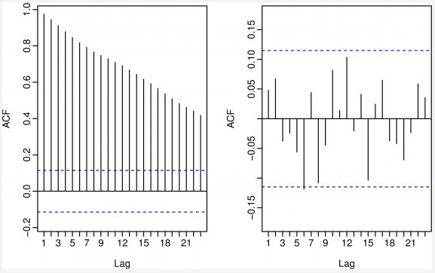
Time Series Analysis – Mathematical Concepts
Stationary Time Series
Definition: If {y_{t}} is a stationary time series, then for all s, the distribution of (y_{t} , . . . , y_{t+s}) does not depend on t.
How to make a series stationary
Differencing - Involves taking difference between successive values.
Log Transformations - makes non - constant variance constant & removes exponential trends.
Identifying non-stationary series
Time plot.
The ACF of stationary data drops to zero quickly. The ACF of non-stationary data decreases slowly.
For non-stationary data, the value of r₁ (first order auto correlation) is often large and positive.
ADF test can also be performed.
Notes:
Time series with trends, or with seasonality, are not stationary — the trend and seasonality will affect the value of the time series at different times. On the other hand, a white noise series is stationary — it does not matter when you observe it, it should look much the same at any period of time.
The left diagram is the acf plot of the original data. (non stationary time series process)
The right diagram is the acf plot of the original data after first order differencing Is performed (stationary time series process)

Slide 21
Time Series Analysis – Mathematical Concepts
Differencing
Differencing helps to stabilize the mean.
The differenced series is the change between each observation in the original series: y_{t}’ = y_{t} − y_{t−1}.
The differenced series will have only T − 1 values since it is not possible to calculate a difference y₁’ for the first observation.
Second-order differencing:
Occasionally the differenced data will not appear stationary and it may be necessary to difference the data a second time:
y_{t}’’ = y_{t}’ - y_{t-1}’’ = (y_{t} - y_{t-1}) - (y_{t-1} - y_{t-2}) = y_{t} -2y_{t-1} + y_{t-2}
y_{t}’’ will have T − 2 values.
In practice, it is almost never necessary to go beyond second-order differences.
Seasonal differencing:
A seasonal difference is the difference between an observation and the corresponding observation from the previous year.
y_{t}’=y_{t} - y_{t-m} , m = number of seasons. m= 12 (monthly), 4 (quarterly), etc.
Notes:
Notes:
When both seasonal and first differences are applied, it makes no difference which is done first ; the result will be the same.
If seasonality is strong, it is recommended that seasonal differencing be done first because sometimes the resulting series will be stationary and there will be no need for further first difference.
It is important that if differencing is used, the differences are interpretable. First differences are the change between one observation and the next. Seasonal differences are the change between one year to the next. Other lags are unlikely to make much interpretable sense and should be avoided.

Slide 22
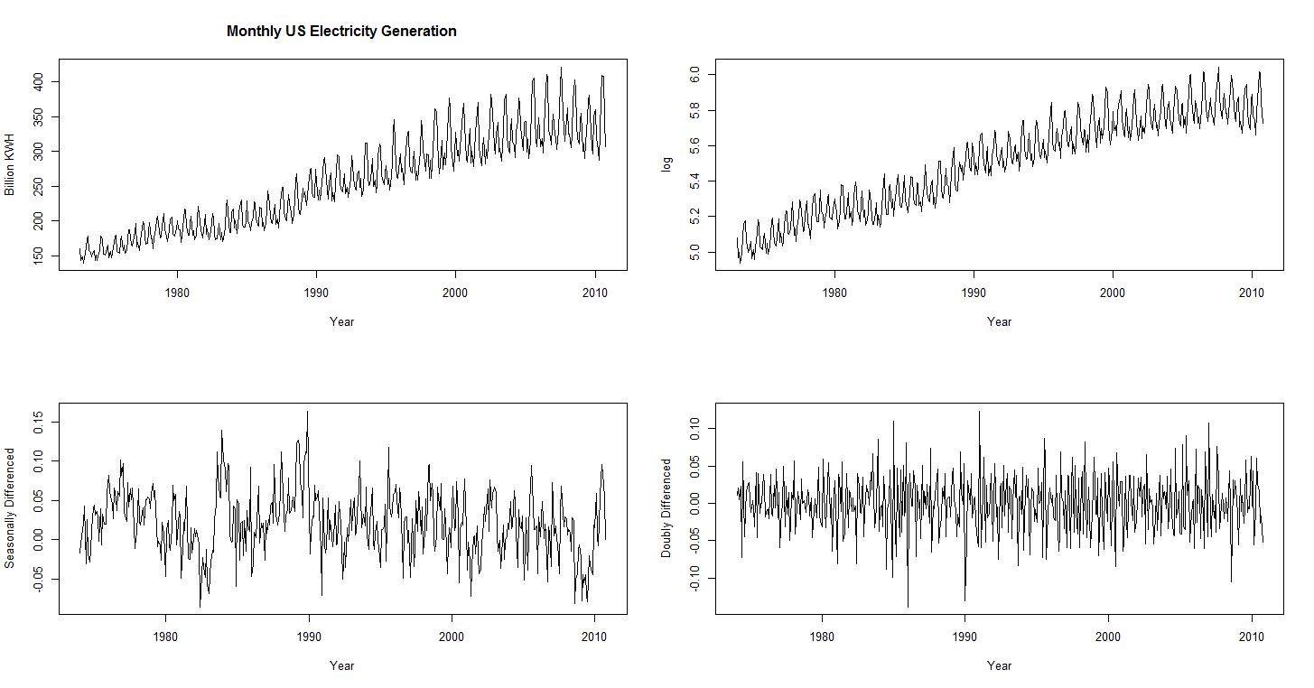
Time Series Analysis – Mathematical Concepts
Differencing
The graphs above are plots for Original Series, series after taking log transformation, the series plot after performing 12th Lag Seasonal Differencing and then the seasonal differenced series is again differenced at first order.
Notes:
Code:
par(mfrow = c(2, 2))
plot(usmelec,main="Monthly US Electricity Generation",ylab="Billion KWH",xlab="Year")
plot(log(usmelec),ylab="log",xlab="Year")
plot(diff(log(usmelec),12),ylab="Seasonally Differenced",xlab="Year")
plot(diff(diff(log(usmelec),12),1),ylab="Doubly Differenced",xlab="Year")

Slide 23
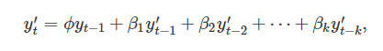
Time Series Analysis – Mathematical Concepts
Differencing – Unit Root Test
One way to determine more objectively if differencing is required is to use a unit root test. These are statistical hypothesis tests of stationarity that are designed for determining whether differencing is required.
One of the most popular tests is the Augmented Dickey-Fuller (ADF) test. For this test, the following regression model is estimated:
where y′_{t} denotes the first-differenced series, y′_{t}=y_{t}−y_{t−1} and k is the number of lags to include in the regression (often set to be about 3).
The null-hypothesis for an ADF test is that the data are non-stationary.
i.e, H₀: Data is non-stationary vs H₁: Data is stationary.
So large p-values are indicative of non-stationarity, and small p-values suggest stationarity. Using the usual 5% threshold, differencing is required if the p-value is greater than 0.05.
Another popular unit root test is the Kwiatkowski-Phillips-Schmidt-Shin (KPSS) test. This reverses the hypotheses,
i.e, H₀: Data is stationary vs H₁: Data is non - stationary.
In this case, small p-values (e.g., less than 0.05) suggest that differencing is required.
Notes:
In R, the default value of k is set to ⌊(T−1)1/3⌋ where T is the length of the time series and ⌊x⌋ means the largest integer not greater than x.
A useful R function is ndiffs() which uses these tests to determine the appropriate number of first differences required for a non-seasonal time series. We can also use nsdiffs() which uses seasonal unit root tests to determine the appropriate number of seasonal differences required.

Slide 24
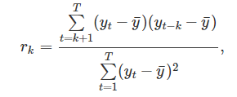
Time Series Analysis – Mathematical Concepts
Autocorrelation and Partial Autocorrelation
Covariance and correlation: measure extent of linear relationship between two variables (y and X).
Auto covariance and autocorrelation: measure linear relationship between lagged values of a time series y_{t}., i.e, we measure the relationship between: y_{t} and y_{t-1}, y_{t} and y_{t-2}, y_{t} and y_{t-3} and so on
Let’s denote the sample autocorrelation at lag k by r_{k}. Then,
Partial autocorrelation is the autocorrelation between y_{t} and y_{t–k} after removing any linear dependence on y₁, y₂, ..., y_{t–k+1}.
The plot with lags on x-axis and correlation (acf/ pacf) on y-axis is known as a correlogram.
ACF plots are useful in identifying whether a time series is stationary or not.
ACF and PACF plots are useful in identifying orders of AR (auto regressive) and MA (moving averages) while forecasting using ARIMA model.

Slide 25
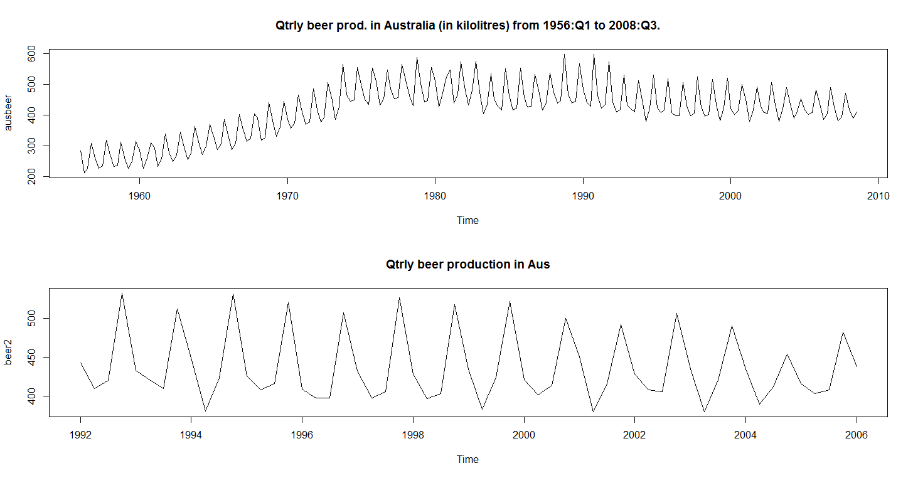
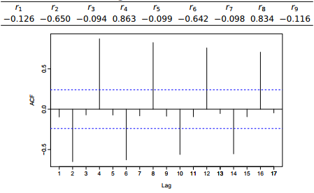
Time Series Analysis – Mathematical Concepts
Interpretation of ACF and PACF
r₄ higher than for the other lags. This is due to the seasonal pattern in the data: the peaks tend to be 4 quarters apart and the troughs tend to be 2 quarters apart.
r₂ is more negative than for the other lag because troughs tend to be 2 quarters behind peaks.
Together, the autocorrelations at lags 1, 2, . . . , make up the autocorrelation or ACF.
Notes:
Code:
Library(fpp)
par(mfrow=c(2,1))
plot(ausbeer,main="Qtrly beer prod. in Australia (in kilolitres) from 1956:Q1 to 2008:Q3.")
beer2 <- window(ausbeer, start=1992, end=2006)
plot(beer2,main="Qtrly beer production in Aus")
#lag.plot(beer2, lags=9, do.lines=FALSE)
acf(beer2,lags=9,plot=F)
acf(beer2)
Tips:
If there is seasonality, the ACF at the seasonal lag (e.g., 12 for monthly data) will be large and positive.
For seasonal monthly data, a large ACF value will be seen at lag 12 and possibly also at lags 24, 36,
For seasonal quarterly data, a large ACF value will be seen at lag 4 and possibly also at lags 8, 12, .
For seasonal weekly data, a large ACF value will be seen at lag 7 and possibly also at lags 14, 21, .
Slowly decaying ACF indicates trend.

Slide 26
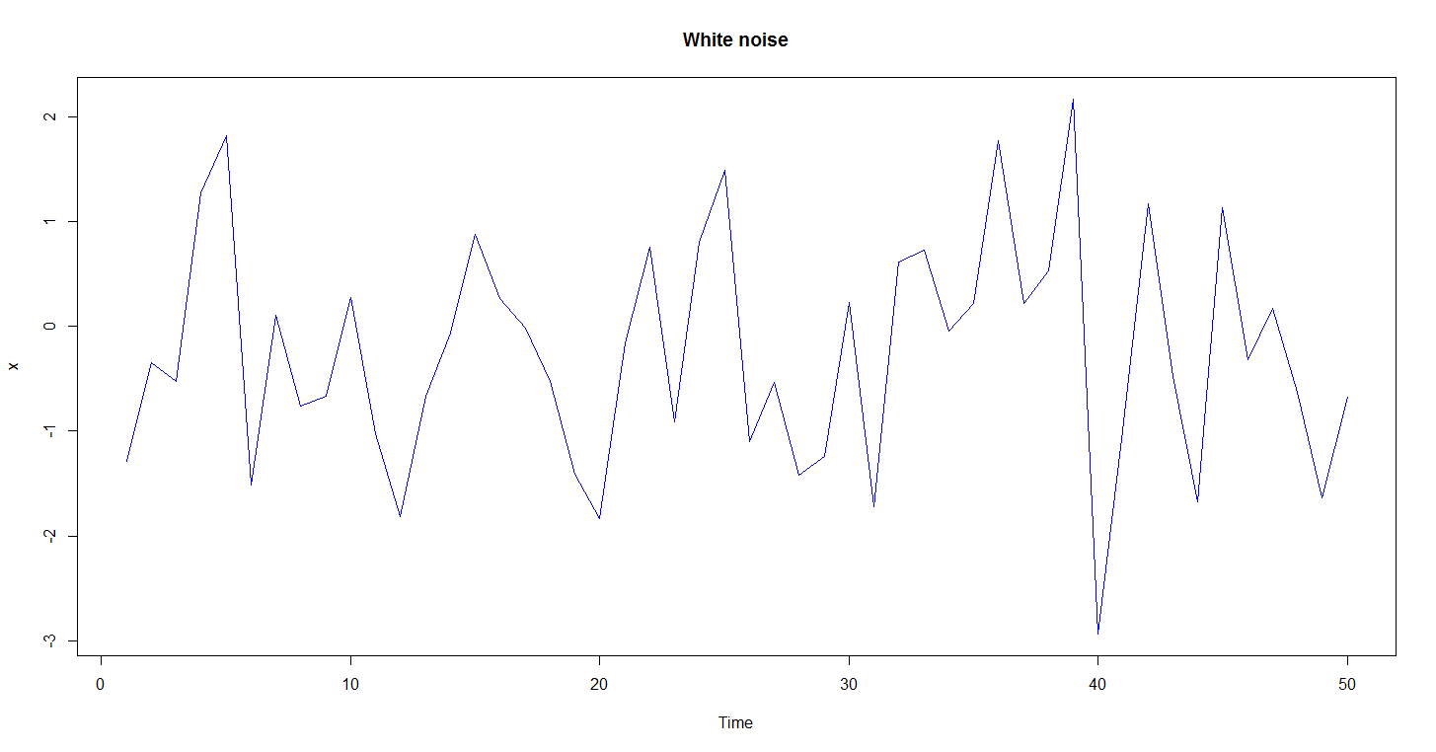
Time Series Analysis – Mathematical Concepts
White Noise
White noise data is uncorrelated across time with zero mean and constant variance. (Technically, we require independence as well.)
Code:
set.seed(30)
x <- ts(rnorm(50))
plot(x, main="White noise",col="blue")
Box.test(x,lag=10)
acf(x)
acf(x,lag=10,plot=F)
Sampling distribution of autocorrelations
Sampling distribution of r_{k} for white noise data is asymptotically N(0,1/T ).
95% of all r_{k} for white noise must lie within ±1.96/ √ T.
If this is not the case, the series is probably not WN.
Common to plot lines at ±1.96/ √ T when plotting ACF. These are the critical values.

Slide 27
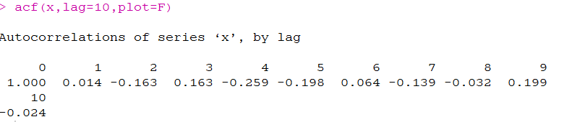
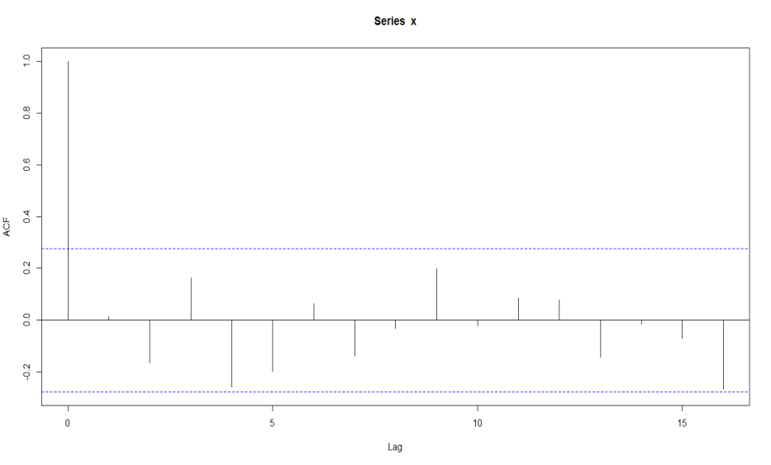
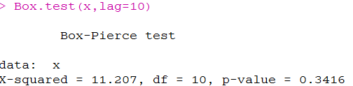
Time Series Analysis – Mathematical Concepts
White Noise
Example: T (no. of data points) = 50 and so critical values at ±1.96/ √ 50 = ±0.28. All autocorrelation coefficients lie within these limits, confirming that the data are white noise. (More precisely, the data cannot be distinguished from white noise.)
Notes:
### Compute the Box-Pierce or Ljung-Box test statistic for examining the null hypothesis of independence in a given time series. These are sometimes known as 'portmanteau' tests.
### H0: Residuals are independently distributed vs H1: Residuals are not independently distributed

Slide 28
Time Series Analysis – Mathematical Concepts
Random Walk
When the differenced series is white noise, the model for the original series can be written as
y_{t} − y_{t−1} = e_{t} or, y_{t} = y_{t−1} + e_{t}
A random walk model is very widely used for non-stationary data, particularly finance and economic data.
Properties:
long periods of apparent trends up or down
sudden and unpredictable changes in direction.
The forecasts from a random walk model are equal to the last observation, as future movements are unpredictable, and are equally likely to be up or down.
A closely related model allows the differences to have a non-zero mean. Then
y_{t} − y_{t−1} = c + e_{t} or, y_{t} = c + y_{t−1} + e_{t}
The value of c is the average of the changes between consecutive observations. If c is positive, then the average change is an increase in the value of y_{t}. Thus y_{t} will tend to drift upwards. But if c is negative, y_{t} will tend to drift downwards.
Notes:
So for the Random Walk model, the best possible forecast would the naïve forecast or the last observed value.

Slide 29
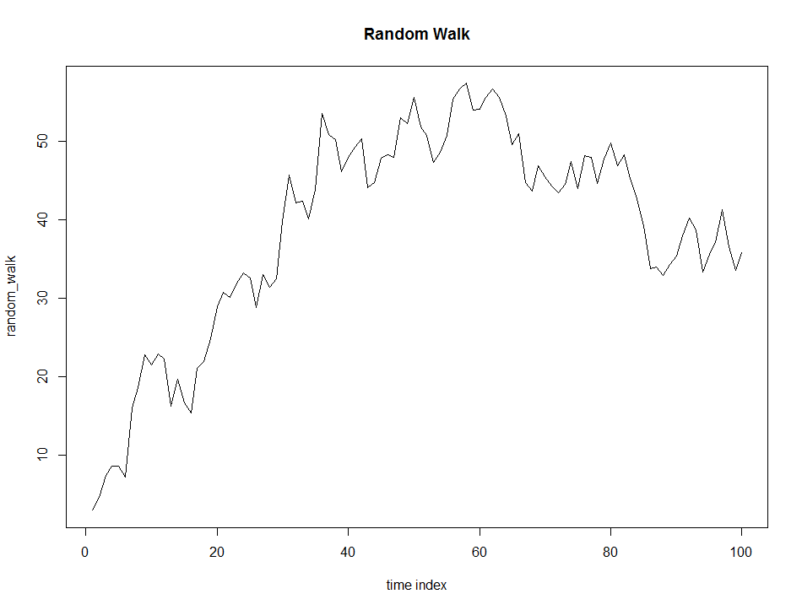
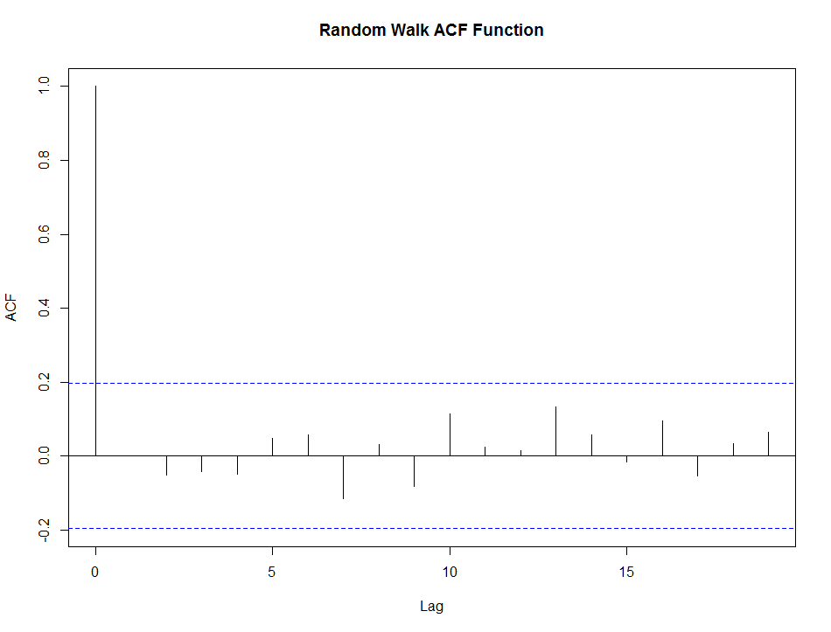
Time Series Analysis – Mathematical Concepts
Random Walk
Code:
set.seed(874234242)
random_walk <- cumsum(rnorm(100, mean = 0, sd = 3.0))
plot(random_walk,type="l",xlab="time index",main="Random Walk")
random_walk_acf<-acf(diff(random_walk))
plot(random_walk_acf, main="Random Walk ACF Function")

Slide 30
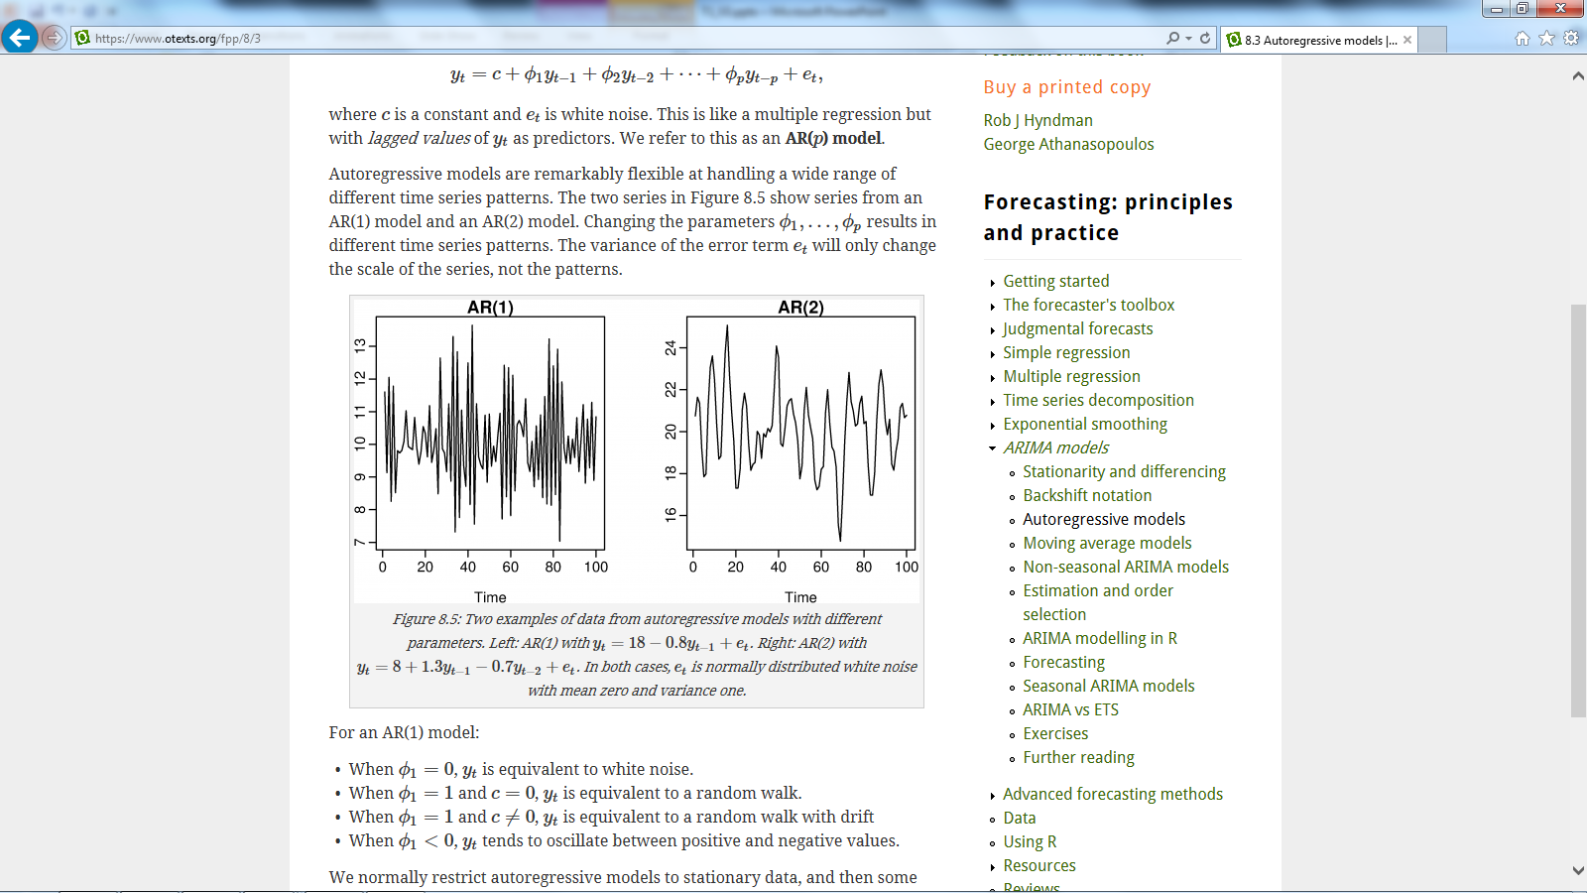
Time Series Analysis
AR Modelling
In an Autoregressive (AR) model, we forecast the variable of interest using a linear combination of past values of the variable. The term auto-regression indicates that it is a regression of the variable against itself.
Thus an autoregressive model of order p can be written as:
where c is a constant and e_{t} is white noise. This is like a multiple regression but with lagged values of y_{t} as predictors. We refer to this as an AR(p) model.
Notes:
Autoregressive models are remarkably flexible at handling a wide range of different time series patterns. The two series in figure above are from an simulated AR(1) model and an AR(2) model. Changing the parameters ϕ₁ ,…,ϕ_{p} results in different time series patterns. The variance of the error term e_{t} will only change the scale of the series, not the patterns.
We normally restrict autoregressive models to stationary data, and then some constraints on the values of the parameters are required.
For an AR(1) model:
−1<ϕ₁<1.
For an AR(2) model:
−1<ϕ₂<1 , ϕ₁+ϕ₂<1, ϕ₂−ϕ₁<1
When p≥3 , the restrictions are much more complicated. R takes care of these restrictions when estimating a model.

Slide 31
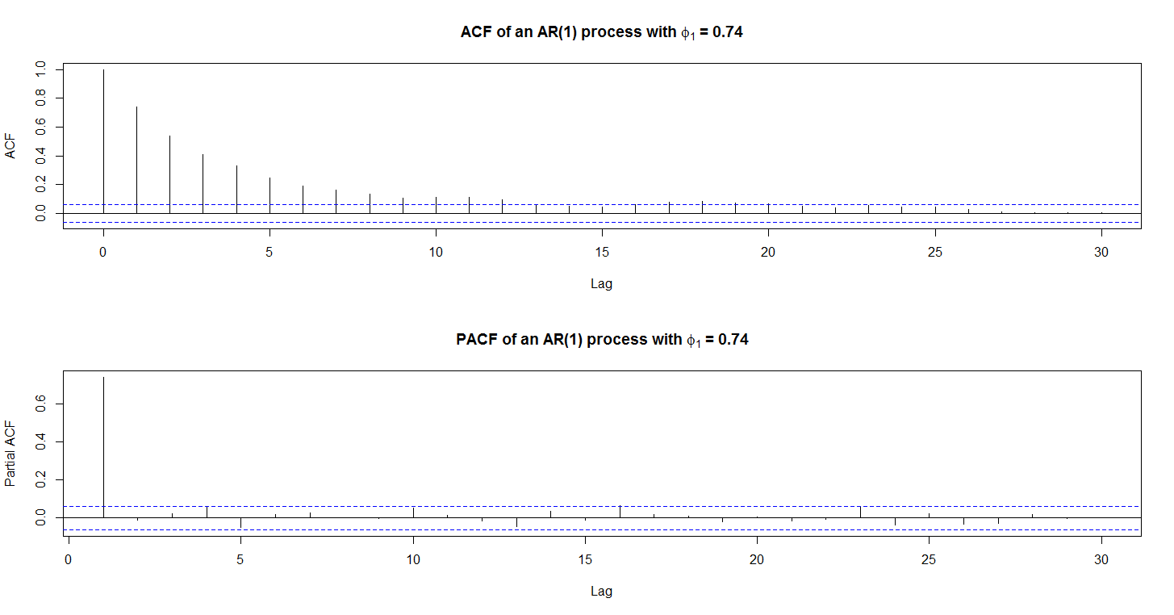
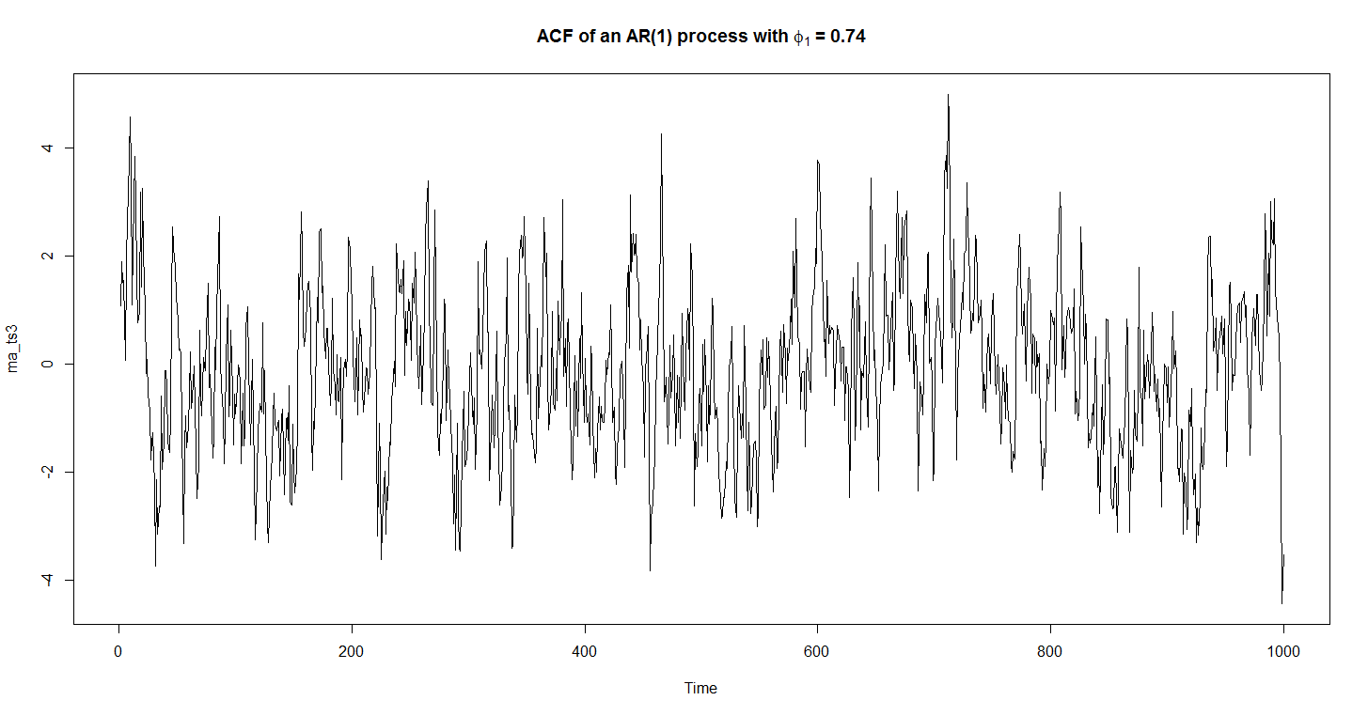
Time Series Analysis
AR Modelling

Slide 32
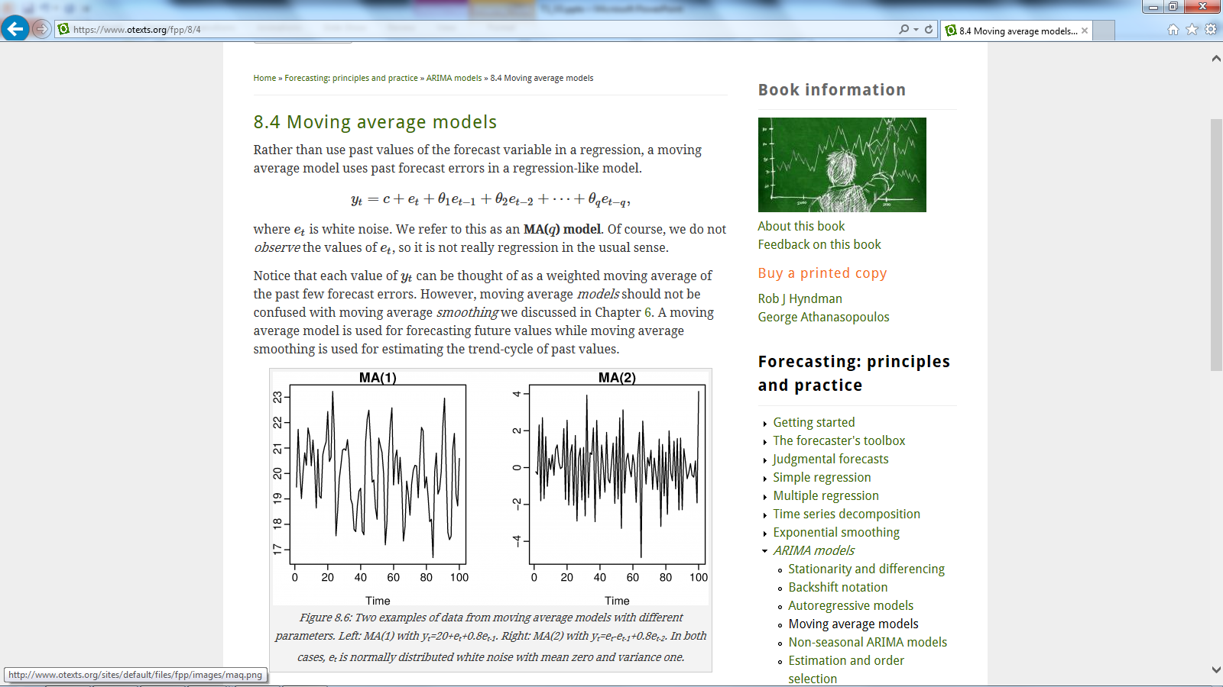
Time Series Analysis
MA Modelling
A Moving Average (MA) model uses past forecast errors in a regression-like model.
where e_{t} is white noise. We refer to this as an MA(q) model. Of course, we do not observe the values of e_{t}, so it is not really regression in the usual sense.
Notice that each value of y_{t} can be thought of as a weighted moving average of the past few forecast errors.
.
Notes:
However, moving average models should not be confused with moving average smoothing. A moving average model is used for forecasting future values while moving average smoothing is used for estimating the trend-cycle of past values.
Restrictions:
For an MA(1) model: −1<θ₁<1
For an MA(2) model:
−1<θ₂<1 , θ₂ +θ₁ >−1, θ₁−θ₂ <1 .
More complicated conditions hold for q≥3 . Again, R will take care of these constraints when estimating the models.

Slide 33
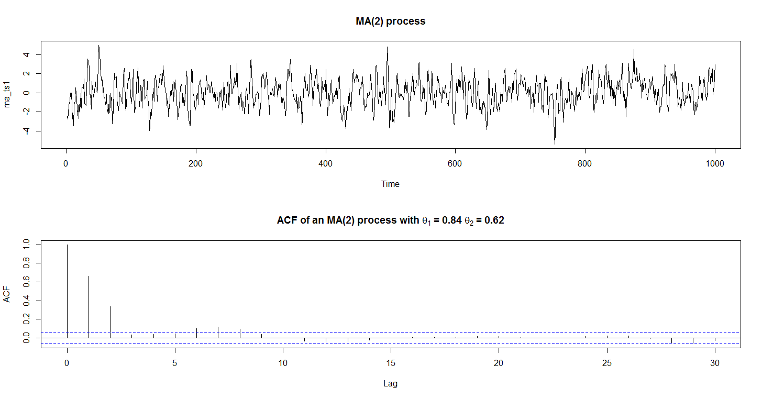
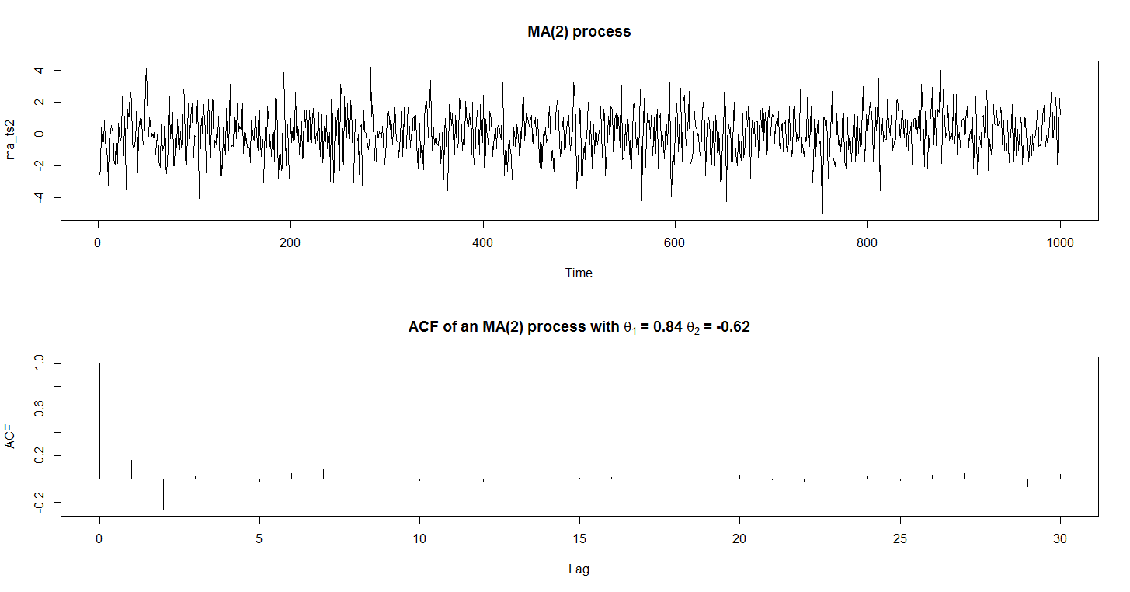
Time Series Analysis
MA Modelling
.

Slide 34
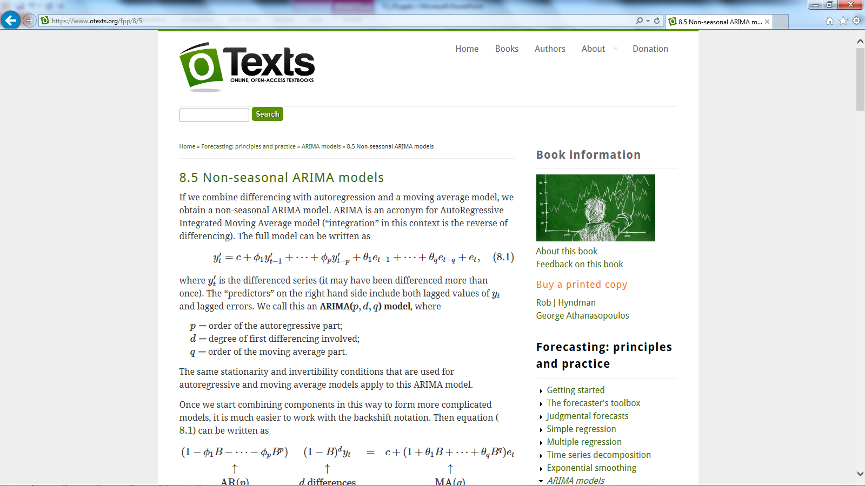
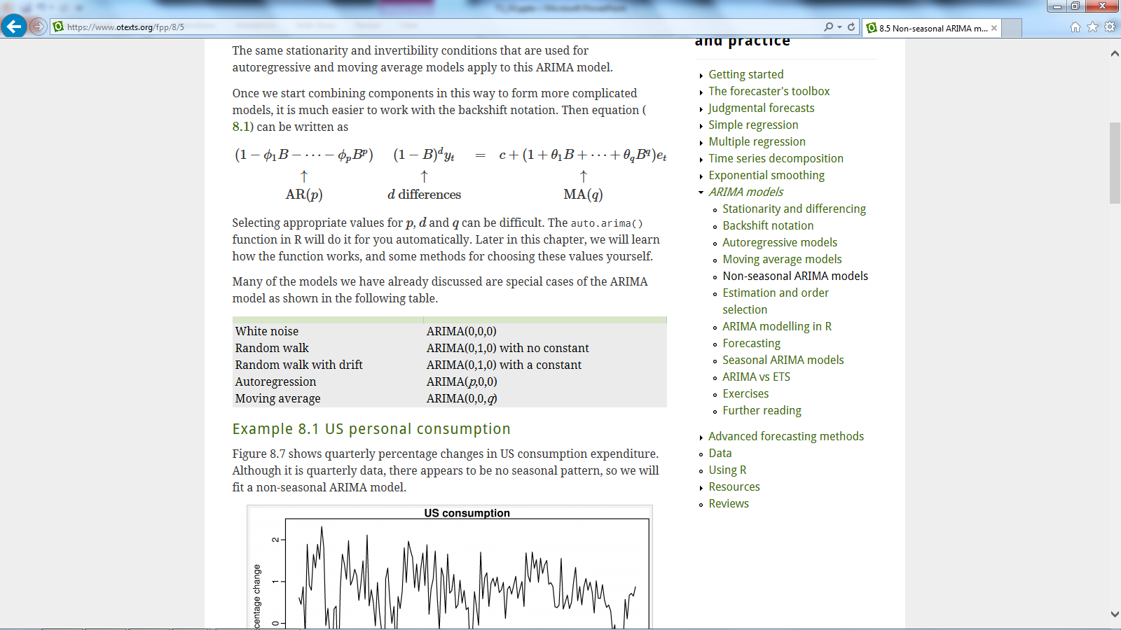
Time Series Analysis
ARIMA Modelling
ARIMA models are, in theory, the most general class of models for forecasting a time series which can be made to be “stationary” by differencing (if necessary), perhaps in conjunction with nonlinear transformations such as logging or deflating (if necessary).
The ARIMA forecasting equation for a stationary time series is a linear (i.e., regression-type) equation in which the predictors consist of lags of the dependent variable and/or lags of the errors. That is:
where y’_{t} is the differenced series (it may have been differenced more than once).
A non-seasonal ARIMA model is classified as an "ARIMA(p,d,q)" model, where:
p is the number of autoregressive terms,
d is the number of non-seasonal differences needed for stationarity, and
q is the number of moving average part.
Many of the models we have already discussed are special cases of the ARIMA model as shown in the following table.
Notes:
The acronym ARIMA stands for Auto-Regressive Integrated Moving Average. Lags of the stationarized series in the forecasting equation are called "autoregressive" terms, lags of the forecast errors are called "moving average" terms, and a time series which needs to be differenced to be made stationary is said to be an "integrated" version of a stationary series. Random-walk and random-trend models, autoregressive models, and exponential smoothing models are all special cases of ARIMA models.

Slide 35
Time Series Analysis
ARIMA Modelling
Identification: Here we need to check – (a) Stationarity / Non-Stationarity (b) Seasonality (c) Order of AR and MA processes (d) White Noise.
Estimation: To specify an ARIMA model to fit to the variable specified and to estimate the parameters of the specified model.
Forecasting: Forecast the future values using the model.
If the data are from an ARIMA(p,d,0) or ARIMA(0,d,q) model, then the ACF and PACF plots can be helpful in determining the value of p or q. If both p and q are positive, then the plots do not help in finding suitable values of p and q .
The data may follow an ARIMA(p,d,0) model if the ACF and PACF plots of the differenced data show the following patterns:
the ACF is exponentially decaying or sinusoidal;
there is a significant spike at lag p in PACF, but none beyond lag p
The data may follow an ARIMA(0,d,q) model if the ACF and PACF plots of the differenced data show the following patterns:
the PACF is exponentially decaying or sinusoidal;
there is a significant spike at lag q in ACF, but none beyond lag q .
We can also use a grid search algorithm which will select the best p,d and q combination for any time series data based on minimizing AIC.

Slide 36
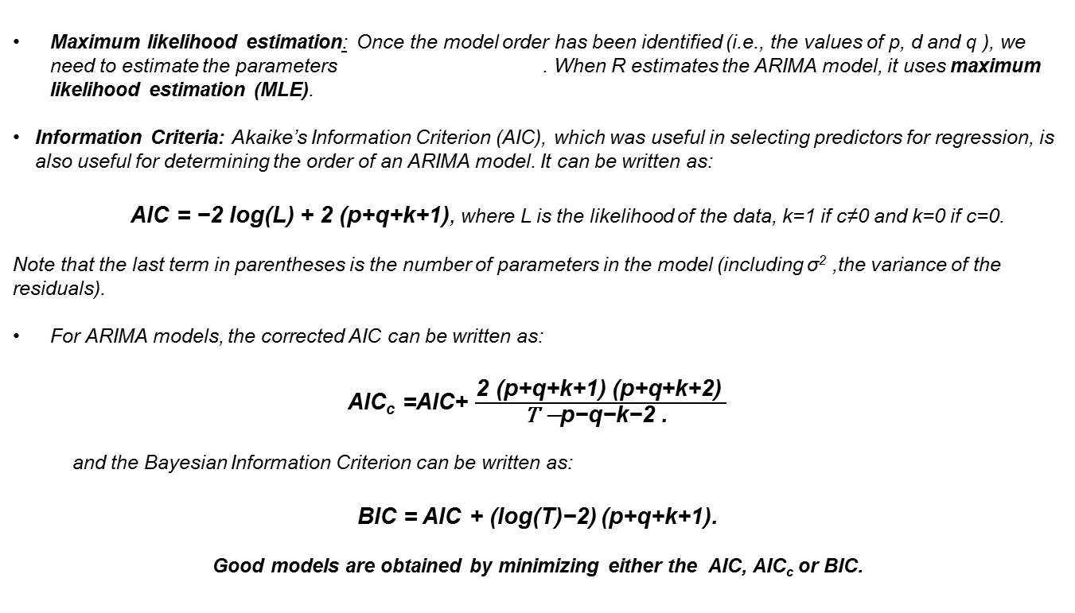
Time Series Analysis
ARIMA Modelling
Maximum likelihood estimation: Once the model order has been identified (i.e., the values of p, d and q ), we need to estimate the parameters . When R estimates the ARIMA model, it uses maximum likelihood estimation (MLE).
Information Criteria: Akaike’s Information Criterion (AIC), which was useful in selecting predictors for regression, is also useful for determining the order of an ARIMA model. It can be written as:
AIC = −2 log(L) + 2 (p+q+k+1), where L is the likelihood of the data, k=1 if c≠0 and k=0 if c=0.
Note that the last term in parentheses is the number of parameters in the model (including σ² ,the variance of the residuals).
For ARIMA models, the corrected AIC can be written as:
AIC_{c} =AIC+ $\frac{\text{2 }\text{(}\text{p}\text{+}\text{q}\text{+}\text{k}\text{+}\text{1}\text{) (}\text{p}\text{+}\text{q}\text{+}\text{k}\text{+}\text{2}\text{) }}{\text{T} \text{−}\text{p}\text{−}\text{q}\text{−}\text{k}\text{−}\text{2 }\text{. }}$
and the Bayesian Information Criterion can be written as:
BIC = AIC + (log(T)−2) (p+q+k+1).
Good models are obtained by minimizing either the AIC, AIC_{c} or BIC.
Notes:
MLE finds the values of the parameters which maximize the probability of obtaining the data that we have observed. For ARIMA models, MLE is very similar to the least squares estimates that would be obtained by minimizing
$$\sum_{t=1}^{T}{{et}^{2}}$$
In practice, R will report the value of the log likelihood of the data; that is, the logarithm of the probability of the observed data coming from the estimated model. For given values of p, d and q. R will try to maximize the log likelihood when finding parameter estimates.

Slide 37
Time Series Analysis
auto.arima()
The auto.arima() function in R uses a variation of the Hyndman and Khandakar algorithm which combines unit root tests, minimization of the AICc and MLE to obtain an ARIMA model. The algorithm follows these steps.
The number of differences d is determined using repeated KPSS tests.
The values of p and q are then chosen by minimizing the AICc after differencing the data d times. Rather than considering every possible combination of p and q, the algorithm uses a stepwise search to traverse the model space.
(a) The best model (with smallest AICc) is selected from the following four:
ARIMA(2,d,2),
ARIMA(0,d,0),
ARIMA(1,d,0),
ARIMA(0,d,1).
If d=0 then the constant c is included; if d≥1 then the constant c is set to zero. This is called the "current model".
(b) Variations on the current model are considered:
vary p and/or q from the current model by ±1;
include/exclude c from the current model.
The best model considered so far (either the current model, or one of these variations) becomes the new current model.
(c) Repeat Step 2(b) until no lower AICc can be found.

Slide 38
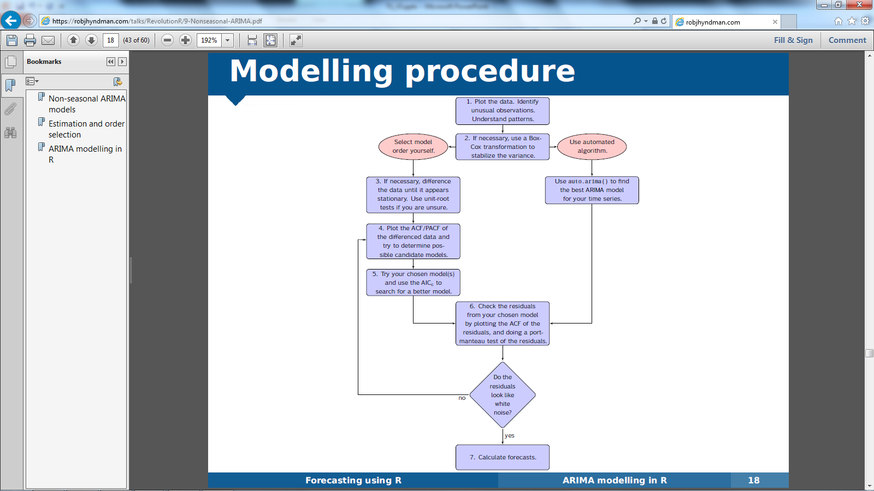
Time Series Analysis
ARIMA Modelling

Slide 39
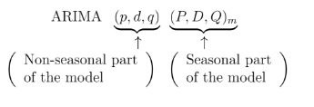
Time Series Analysis
Seasonal ARIMA models
ARIMA models are also capable of modelling a wide range of seasonal data. A seasonal ARIMA model is formed by including additional seasonal terms in the ARIMA models we have seen so far. It is written as follows:
where m = number of periods per season. We use uppercase notation for the seasonal parts of the model, and lowercase notation for the non-seasonal parts of the model.
ACF/PACF
The seasonal part of an AR or MA model will be seen in the seasonal lags of the PACF and ACF. For example, an ARIMA(0,0,0)(0,0,1)₁₂ model will show:
a spike at lag 12 in the ACF but no other significant spikes.
The PACF will show exponential decay in the seasonal lags; that is, at lags 12, 24, 36, ….
Similarly, an ARIMA(0,0,0)(1,0,0)₁₂ model will show:
exponential decay in the seasonal lags of the ACF
a single significant spike at lag 12 in the PACF.
Notes:
In considering the appropriate seasonal orders for an ARIMA model, restrict attention to the seasonal lags. The modelling procedure is almost the same as for non-seasonal data, except that we need to select seasonal AR and MA terms as well as the non-seasonal components of the model.

Slide 40
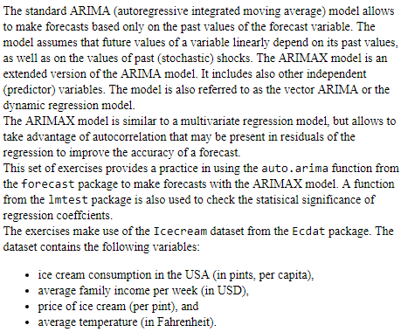
ARIMAX
Use case
Code: model <- Arima(usage, order=c(0,0,0), seasonal=list(order=c(1,0,0), period=24), xreg=xreg)

Slide 41
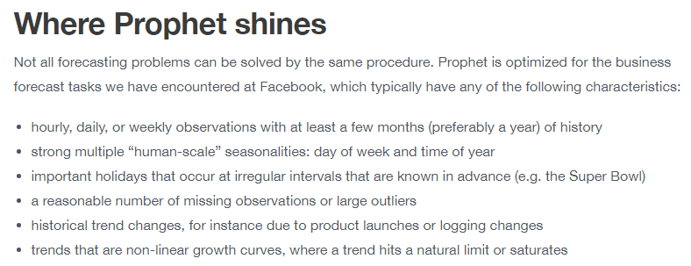
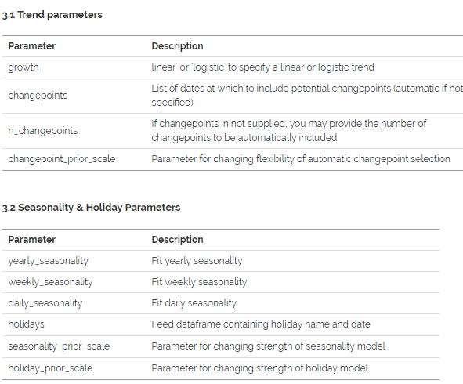
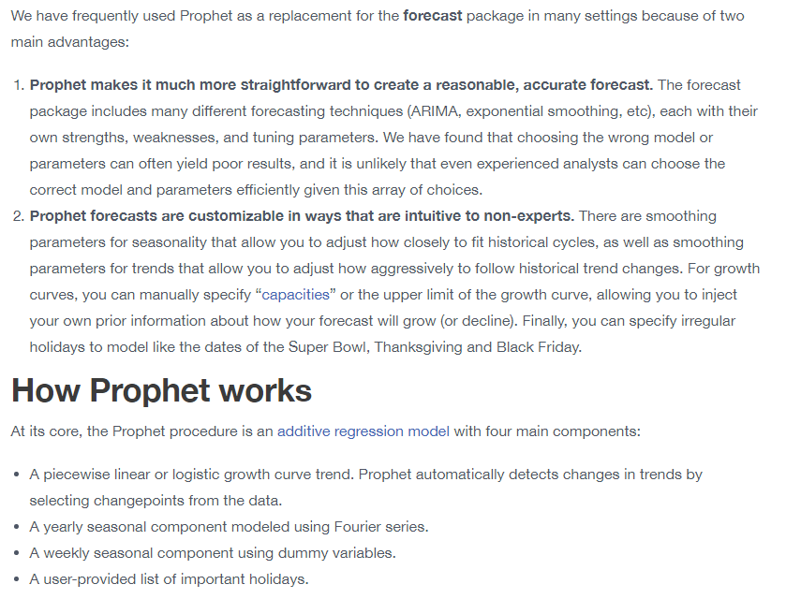
Prophet

Slide 42
Time Series Analysis – References

Slide 43
Appendix

Slide 44
Time Series Analysis – Forecasting Models
Multivariate/Univariate-Forecast | Description
Naïve Forecast/Indexing | Naïve/ Seasonal Naïve and Indexing are two different Methods
MA | Simple Moving Average Method
SVM | Support Vector Regression
MAD | Moving Average model with Seasonal Decomposition
Judgmental Forecast-Delphi Method | When we don’t have any prior information of the series
ESM | Various types of Exponential Smoothing Method
KNN | K-Nearest Neighborhood Method
LR | Linear Regression Model
LR-1 (with L1 regularization) | In case of Binary data-Logistic Regression with L1 Regularization
ARIMA(X) | Auto Regressive Integrated Moving Average
VARMAX/VAR | Vector Auto Regressive Moving Average method with Exogenous Variables
PLS | Partial Least Square method
LASSO | least absolute shrinkage and selection operator
GAM | Generalized Additive Model
Theta Model | A new variant of Time Series Model
BNN | Bayesian Network Model
ANN | Artificial Neural Network
UCM | Unobserved Component Model-Kalman Filters
LSTM-RNN | The Long Short-Term Memory network- Recurrent Neural Network
HF | Hierarchical Forecasting for Grouped Data
State-Space Model | Multivariate time series through auxiliary variables

Slide 45
Time Series Analysis
Decomposition of a time series (STL)
STL is a very versatile and robust method for decomposing time series. STL is an acronym for “Seasonal and Trend decomposition using Loess”, while Loess is a method for estimating nonlinear relationships.
STL has several advantages over the classical decomposition method :
STL will handle any type of seasonality, not only monthly and quarterly data.
The seasonal component is allowed to change over time, and the rate of change can be controlled by the user.
The smoothness of the trend-cycle can also be controlled by the user.
It can be robust to outliers (i.e., the user can specify a robust decomposition). So occasional unusual observations will not affect the estimates of the trend-cycle and seasonal components. They will, however, affect the remainder component.
On the other hand, STL has some disadvantages.
In particular, it does not automatically handle trading day or calendar variation, and it only provides facilities for additive decompositions.
For multiplicative time series, we can however take log transformation of the series and then apply STL decomposition.

Slide 46
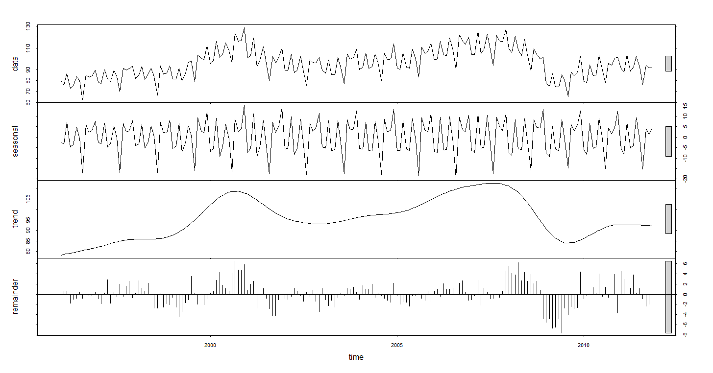
Time Series Analysis
Decomposition of a time series (STL)
R Code:
library(fpp)
fit <- stl(elecequip, s.window=5)
plot(fit)

Slide 47
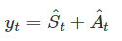
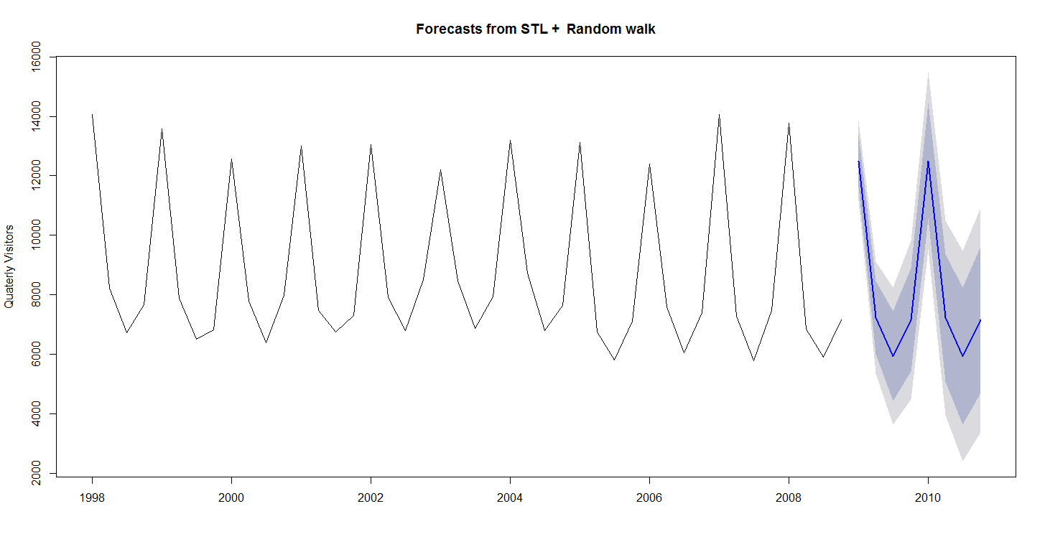
Time Series Analysis – Decomposition Based Models
STL Model
While decomposition is primarily useful for studying time series data, and exploring the historical changes over time, it can also be used in forecasting.
Assuming an additive decomposition, the decomposed time series can be written as
Where A_{t} = T_{t} + E_{t} is the seasonally adjusted component.
To forecast a decomposed time series, we separately forecast the seasonal component, S_{t}, and the seasonally adjusted component A_{t}. It is usually assumed that the seasonal component is unchanging, or changing extremely slowly, and so it is forecast by simply taking the last year of the estimated component. In other words, a seasonal naïve method is used for the seasonal component.
To forecast the seasonally adjusted component, any non-seasonal forecasting method may be used. For example, a random walk with drift model, or Holt’s method (discussed in the next chapter), or a non-seasonal ARIMA model may be used.

Slide 48

Time Series Analysis – Decomposition Based Models
Theta Model
Understanding the THETA Method: The core idea behind the Theta method is the decomposition of a time series into two lines. One representing a long-term trend, and the other captures short-term dynamics. The lines are known as theta lines, and are used to predict the original time series. The model forecast is a weighted average of the predictions obtained by the theta lines.
The Theta method is based on the modification of the local curvatures of a time series through the Theta (θ) coefficient. A theta line is a weighted linear combination of the original time series data and a linear trend. For example, given the original time series Y(t) a theta line can be calculated as:
Where (alpha + Beta*t) is the fitted time trend whose parameters Alpha-hat is the intercept and Beta-hat is the Slope estimated from the Data.
To get a feel for these theta lines consider the case where Theta =0 then the equation simply represent Linear Regression Equation of the Time Trend. It essentially removes the curvature of the data to estimate the long-term trend component.
Steps in the THETA Method:
Theta is a dynamic forecasting methodology, so you can choose the number of theta line to use
The Standard Theta Method (STM) uses two theta lines, with ad-hock values for θ, and equal weights for the combination of the final forecasts.
First, the Time Series is examined for seasonality using the auto-correlation function. A statistical test of Auto-Correlation is used to determine if the Seasonality component is Significant.
If Seasonality is evident , perform a seasonal decomposition assuming a multiplicative relationship of the Seasonal Components.
The time series is decomposed into two lines, the linear regression time trend Z_{t}(0), and the theta line Z_{t}(2). Notice Z_{t}(2) doubles the local curvatures of the series to approximate the short-term behavior.

Slide 49
Time Series Analysis – Decomposition Based Models
Steps for Theta Method Estimation
Z_{t}(0) is extrapolated by linear regression, and Z_{t}(2) is extrapolated using the simple exponential smoothing model.
The forecasts produced from the extrapolation of the two lines are combined with equal weights (50%-50%).
Finally if the forecasts were de-seasonalised in step-1 , the seasonal component is added back to arrive at the final Forecast.
Alternative Theta Method: The Optimized theta method (OTM) offers a slight variation on Simple theta method (STM) but computationally more intensive. In the OTM, θ(hat) is obtained by minimizing the one step ahead prediction error.
The Dynamic Optimized Theta Model (DOTM) uses a state space model to select the best short-term theta line and dynamically revises the long-term theta.
Advantage of Theta Method: The basic theta method is very simple to understand. It only uses two lines (Z_{t}(0), and Z_{t}(2)) to generate forecasts. It does not require extensive training in statistics or detailed mathematical knowledge before it can be applied. It can be used on data with or without a trend, and whether seasonality is present.

Slide 50

Time Series Analysis– Decomposition Based Models
Theta Method – Overview -1

Slide 51

Time Series Analysis– Decomposition Based Models
Theta Method – Overview -2

Slide 52

Time Series Analysis– Decomposition Based Models
Theta Method – Overview -3

Slide 53
Time Series Analysis– Decomposition Based Models
BATS/ TBATS
Traditional statistical techniques for TS forecasting are well-suited for dealing with seasonality at multiple levels. In other words, where seasonality occurs simultaneously within a hour, day and week etc. BATS, and an extension called TBATS were developed specifically to address such problems. They decompose a time series to capture the trend and seasonal factors which can include long-run cycles, monthly seasonality, day of week effects and so on.
BATS and TBATS models make it possible to forecast data with more than one type of seasonality. This can enhance prediction accuracy, and increase the likelihood of "buy-in" from potential stake holders
Understanding the TBATS/BATS Method: Any classical decomposition model for a time series Y_{(t)} can take the form of:
Y(t) = Trend x Seasonality x Error ……………………[Multiplicative Model]
Trend + Seasonality + Error …………………..[Additive Model]
In practice, a TS may have many levels of seasonality. We can capture this with the factor S_{i} , where i= 1…T
refers to a total of T-levels of Seasonality in the Time Series. For example, if T = 4, s1 might capture a pattern repeating every year, s2 a pattern repeating every month, s3 weekly seasonality, and finally s4 might capture daily seasonality. The BATS and TBATS models are capable of handling such multiple levels of seasonality.

Slide 54

Time Series Analysis– Decomposition Based Models
BATS/ TBATS

Slide 55
Time Series Analysis– Decomposition Based Models
BATS/ TBATS
Advantages:
The key feature of BATS/TBATS models is that they allow to model wide varieties of seasonal patterns.
The TBATS model is useful when a time series with a complicated seasonal pattern is encountered. It can deal with complex types of seasonality such as multiple seasonal components.
It also handles nonlinear features in time series. Finally, both BATS and TBATS take autocorrelation in residuals into account.
The TBATS model reduces the parameter space without a negative impact on the predictive accuracy. It requires the estimation of 2 (k₁, k_{2,} k₃ ... k_{T}) initial values. This number is generally smaller than the number of seed parameters required by BATS models.
Disadvantages:
It is possible to fit ARIMA models with multiple seasonal components as Fourier terms, and often this approach will give similar results to the TBATS model. However, TBATS is preferable if seasonality changes over time, in addition the approach is fully automated. The core downside is that you cannot include explanatory covariates (such as time of day, or knowledge about an advertising campaign) as additional independent variables in the TBATS framework.
The BATS and TBATS models are based on a state space model with a single error. These types of models are designed for use when there are multiple cyclical patterns (eg. Daily, Weekly and Yearly Pattern).

